Slide 1

MTN SCRMS GUIDEBOOK
By Awoof Energy Limited

Slide 2
Table Of Contents
Application Overview
Application Flow Diagram
Authentication
Login
First Time User
Recurrent User
Recover Password
Change Password When Signed In
Logout

Slide 3
System Requirements
Users
Create User
View all Users
View Single User
Edit User’s Detail
Shift
Move security staff to shift
View staff in shift
Note: To change a staff shift, simply move the staff to a new shift.

Slide 4
Vehicle
Create New Vehicle
View all Vehicles
View free vehicles
View vehicles in use
View & edit a vehicle
Police
Add a new police
View all policemen
View & edit a policeman

Slide 5
Patrol Team
Create new patrol team
View all patrol teams
View & edit a patrol team
Escalation Levels (Higher privilege)
Create new escalation level
Add staff or group of staffs to escalation level
View all escalation levels
View & edit an escalation level

Slide 6
Incident Type
Create new incident type
View all incident types
View & edit an incident type
Notification Settings (Higher privilege)
Modify notification options
Modify email templates
Modify SMS templates
SMS gateway settings

Slide 7
Authentication Settings (Higher privilege)
Password settings
Account lockout requirement
General Application Settings (Higher privilege)
Application name
Application logo
Company motto
Incident pop-up duration
Incident pop-up time interval
System inactivity time
Shift settings

Slide 8
Task Management
Note: When an incident is created that requires patrol intervention, a task will be created automatically.
Create an escort task
View all tasks
View & edit a task information
Start a task
Complete a task
Return a vehicle after task completed
Reassign a task
Cancel a task
Reopen a canceled task

Slide 9
Incident Management
Report an incident
View all reported incidents
View & edit a incident record
Close an incident
Reopen an incident
Reports
Incident reports
Task reports
Handover Tasks

Slide 10
1.
Application Overview

Slide 11
MTN security control room management application is a platform where incidents and tasks are managed to bring about improved response times, proper record keeping, instantaneous access to data, data security and verifiability and performance tracking.

Slide 12
This document is meant to be a guidebook on the standard operating procedures and usage of most components of the MTN SCRMS

Slide 13
There are two key activities recorded in the application and they are; reported incidents, and assigned tasks.
When an incident that requires a patrol team response is created, a task is created automatically.
But tasks cannot be created if there is no patrol team on duty at the time of task creation. So this guidebook helps the user to understand the features of the application that should be setup every time work resumes to enable smooth running of the application.

Slide 14
2.
Application Flow Diagram

Slide 15
Report Incident Flow Diagram
Click on “Report Incident”
Search for staff affected
Enter the reported incident in the form provided and submit
Staff affected manager and the associated escalation group(s) will be notified
Note: If patrol team is required for the given incident, an automated task will be created. Notifications are also done automatically.

Slide 16
Task Creation Flow Diagram
Enter the task information in the form provided
Click on “Add Task”
Once the form is submitted, notifications will be sent to the supervisors, and line managers for follow-ups.
Note: Once a task has been created, there is need to track the progress of the task such as begin the task, complete the task, return the vehicle used for the task to the site, cancel a task where necessary, or reassign the task to someone else.

Slide 17
Early Morning Routine
Login
Dashboard
Put supervisors in the correct shift
Create or activate supervisor’s
Patrol team for the given shift
Note: If a required supervisor is not yet a user on the platform, you cannot add him to a patrol team, contact an admin to create a user account for the person.

Slide 18
Task Progress Flow Diagram
Create a task
Begin a task
Give task to someone else
Cancel a task
Cancel a task
Complete a task
Re-assign task
Return vehicle
Cancel task
Note: You can see from the arrows how that you can do some things when you’ve done a thing and you can’t do some other things. But every task that is created and begun must have its vehicle returned. When a created task is created and never started, please remember to cancel it.

Slide 19
3.
Authentication

Slide 20
Login
When logging in, you may be doing that for the first time or recurrently.
A first time user will need to change his password before logging in.
Please use the slides below to understand better.

Slide 21
First Time Login
Visit the MTN application on “ojtsecontrol01.mtn.com.ng
Enter your correct user credentials, you will receive a token in your email.
Note: Your username is your email address. Also, if your user account has
been created, you will find your login details in your email.
Enter the token you received in the six boxes provided, you will be redirected
to a screen where you change your password.
Enter a password of your choice and submit.
Voila, you’re in.

Slide 22
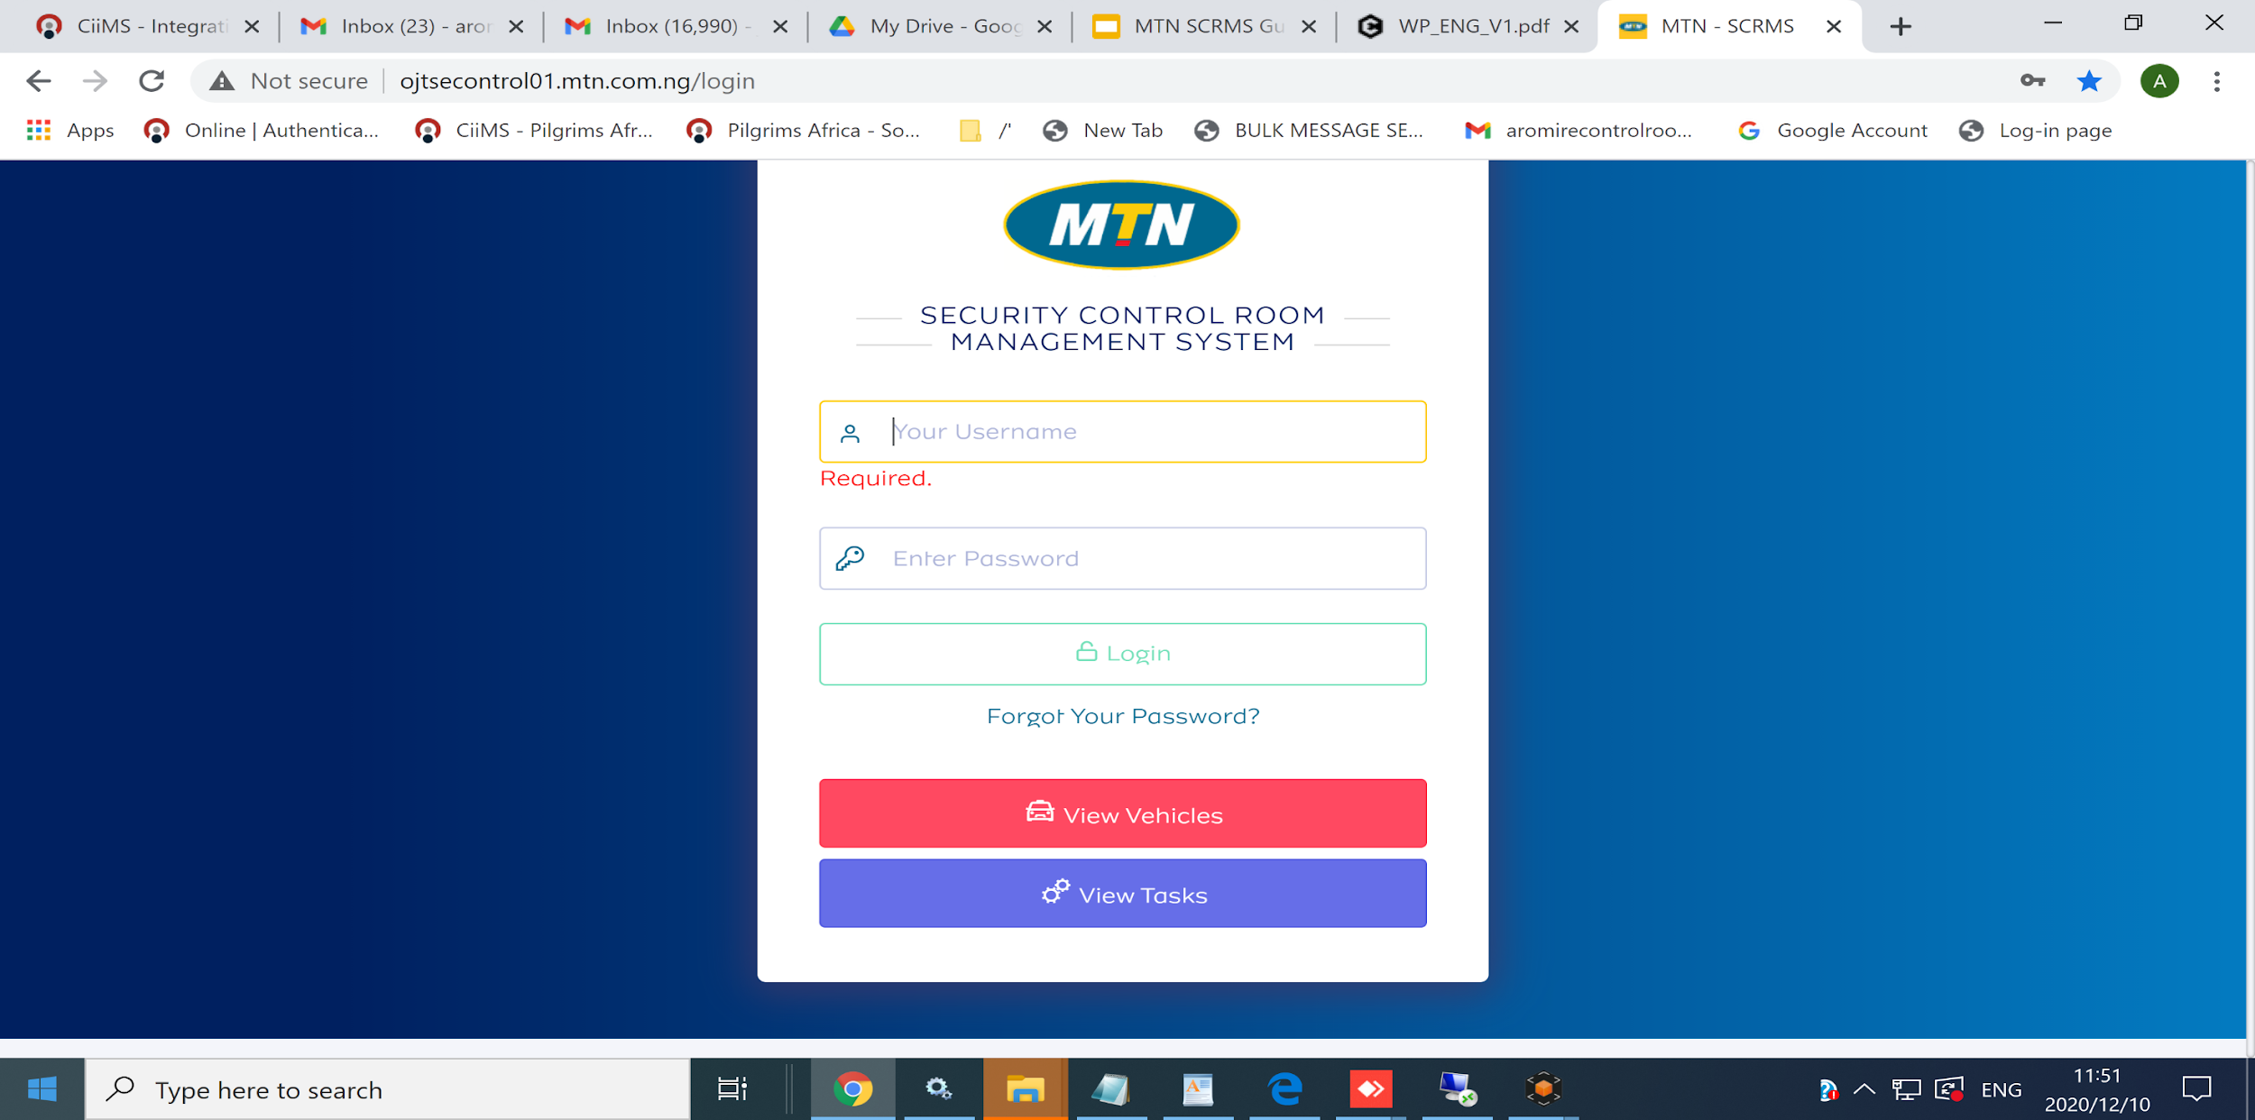
First Time Login > 1 > “Open app and enter details”
After submitting, check your email for token sent.
Back to table of Contents

Slide 23
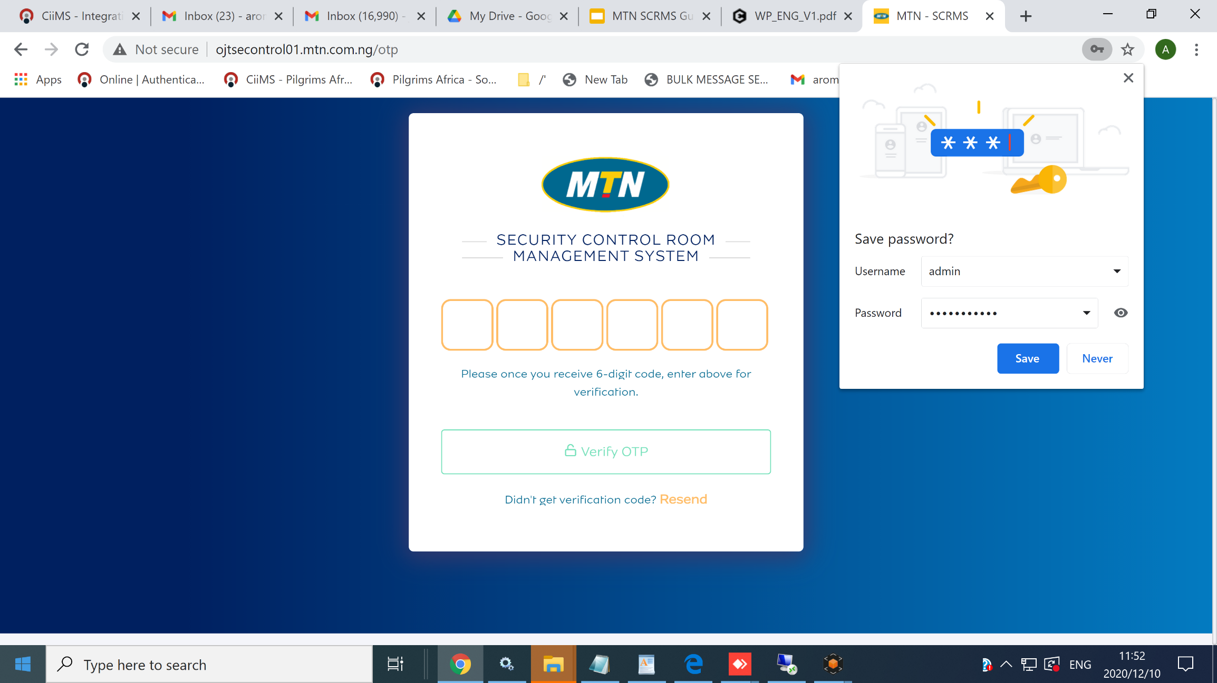
First Time Login > 2 > “Enter token”
You will be redirected to a screen where you change your password
Back to table of Contents

Slide 24
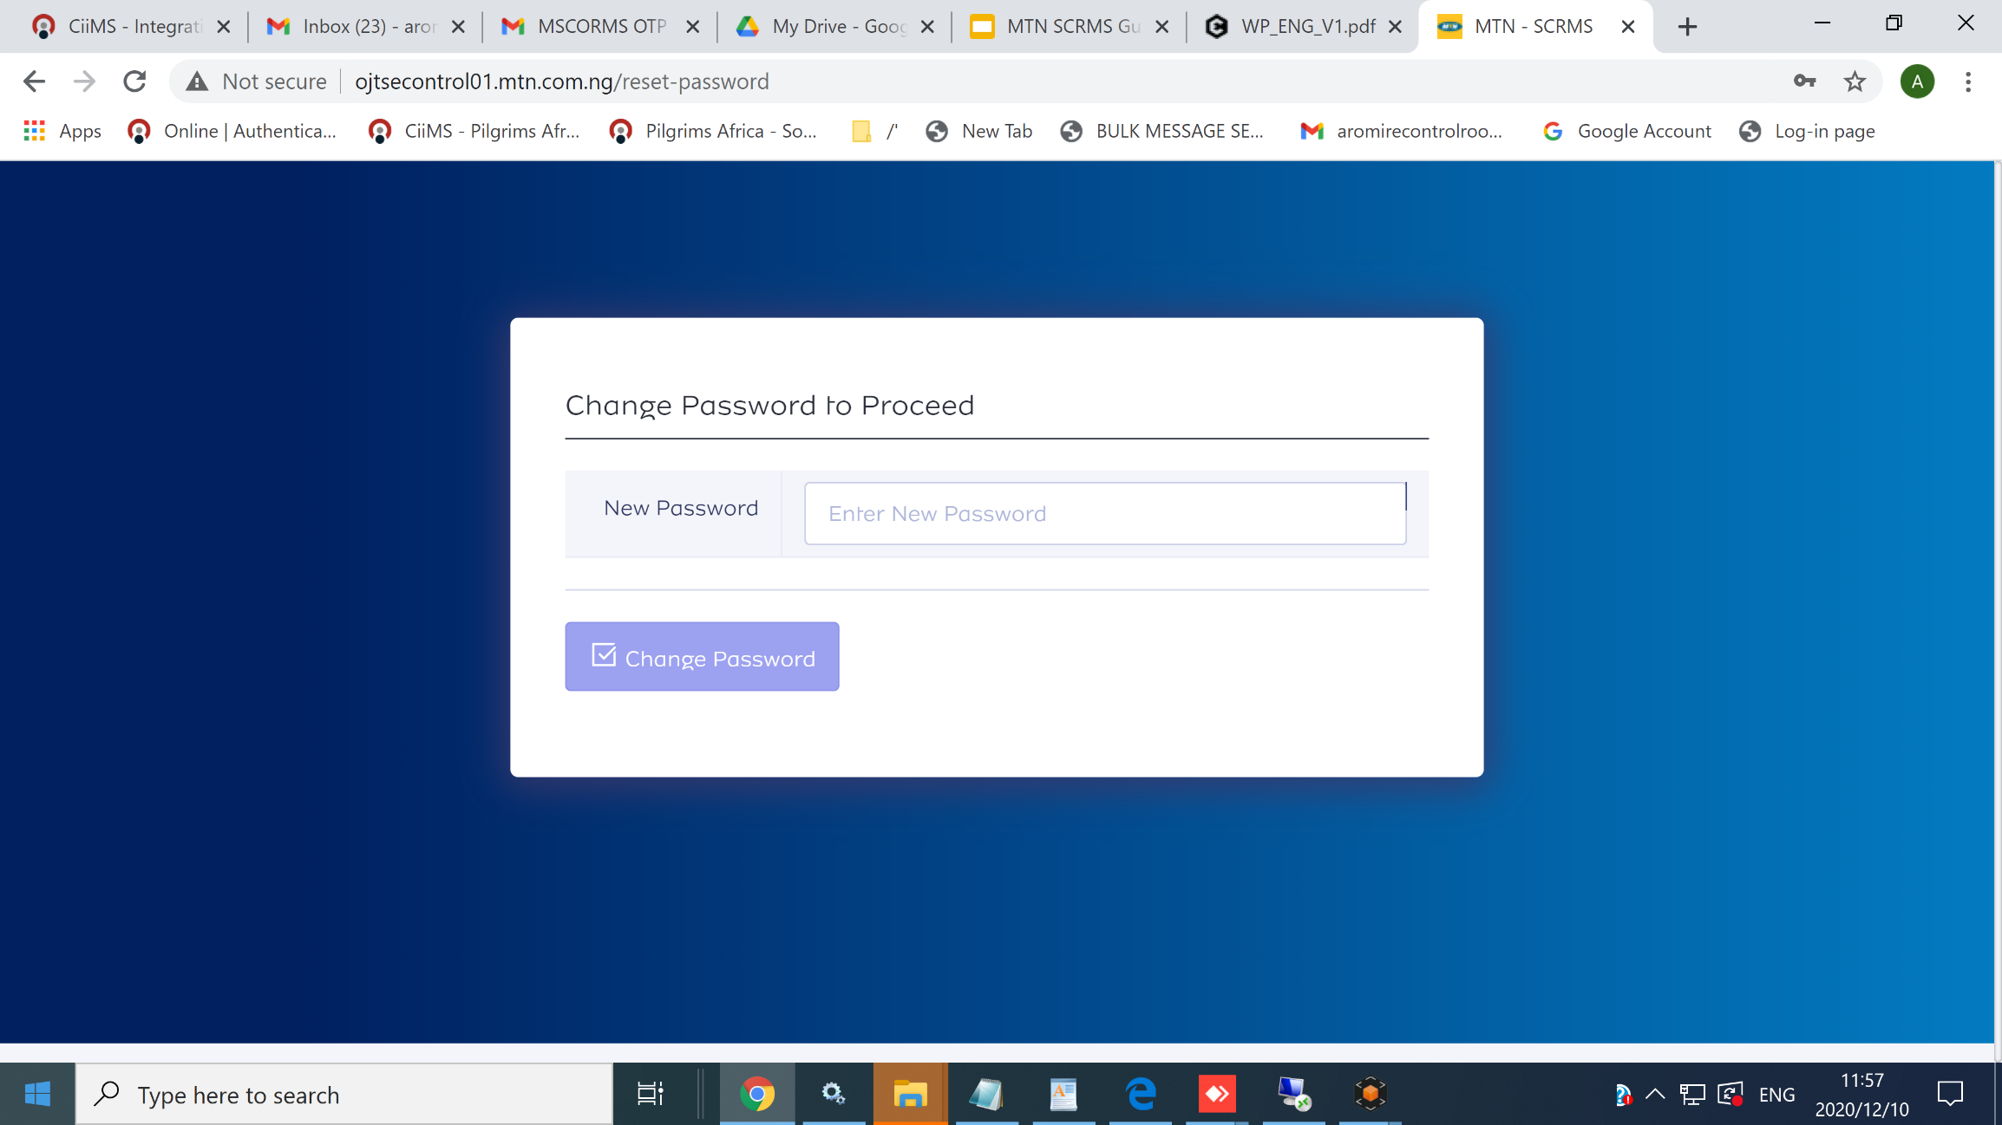
First Time Login > 3 > “Enter new password”
Make a strong password, then submit. You’re now taken to dashboard.
Back to table of Contents

Slide 25
Recurring Login
Visit the MTN application on “ojtsecontrol01.mtn.com.ng
Enter your correct user credentials, you will receive a token in your email.
Note: Your username is your email address. Also, if your user account has
been created, you will find your login details in your email.
Enter the token you received in the six boxes provided, you will be redirected
to a screen where you change your password.
Enter a password of your choice and submit.
Voila, you’re in.

Slide 26
Recurring Login > 1 > “Open app and enter details”
After submitting, check your email for token sent.
Back to table of Contents

Slide 27
Recurring Login > 2 > “Enter token”
You will be redirected to your dashboard
Back to table of Contents

Slide 28
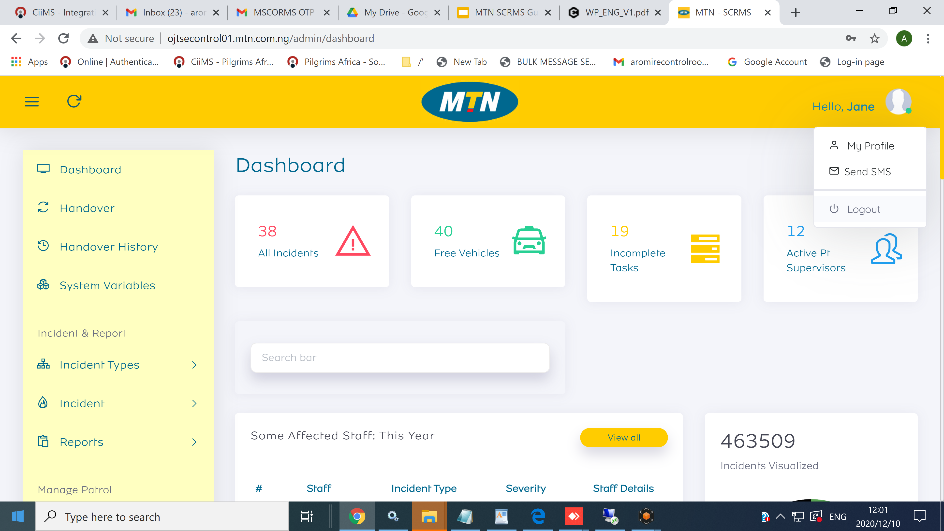
Recurring Login > 3 > “You are shown your dashboard”
You can find some reports and menus right on your dashboard.
Back to table of Contents

Slide 29
4.
System Requirements

Slide 30
Create User
To be able to access the resources on the system or to be qualified to be assigned tasks on the system, one needs a user credential.
Creating a new user credential is a sole function of the application administrator.
For the time being, anyone who must be a user on the system needs to have his/her information already stored in the MTN active directory.

Slide 31
Create User Steps
Locate “user” on the menu panel and click on “Add User”
Fill the form that shows up.
Note: There are some fields that are mandatory, and these are;
Region
Password
Role

Slide 32
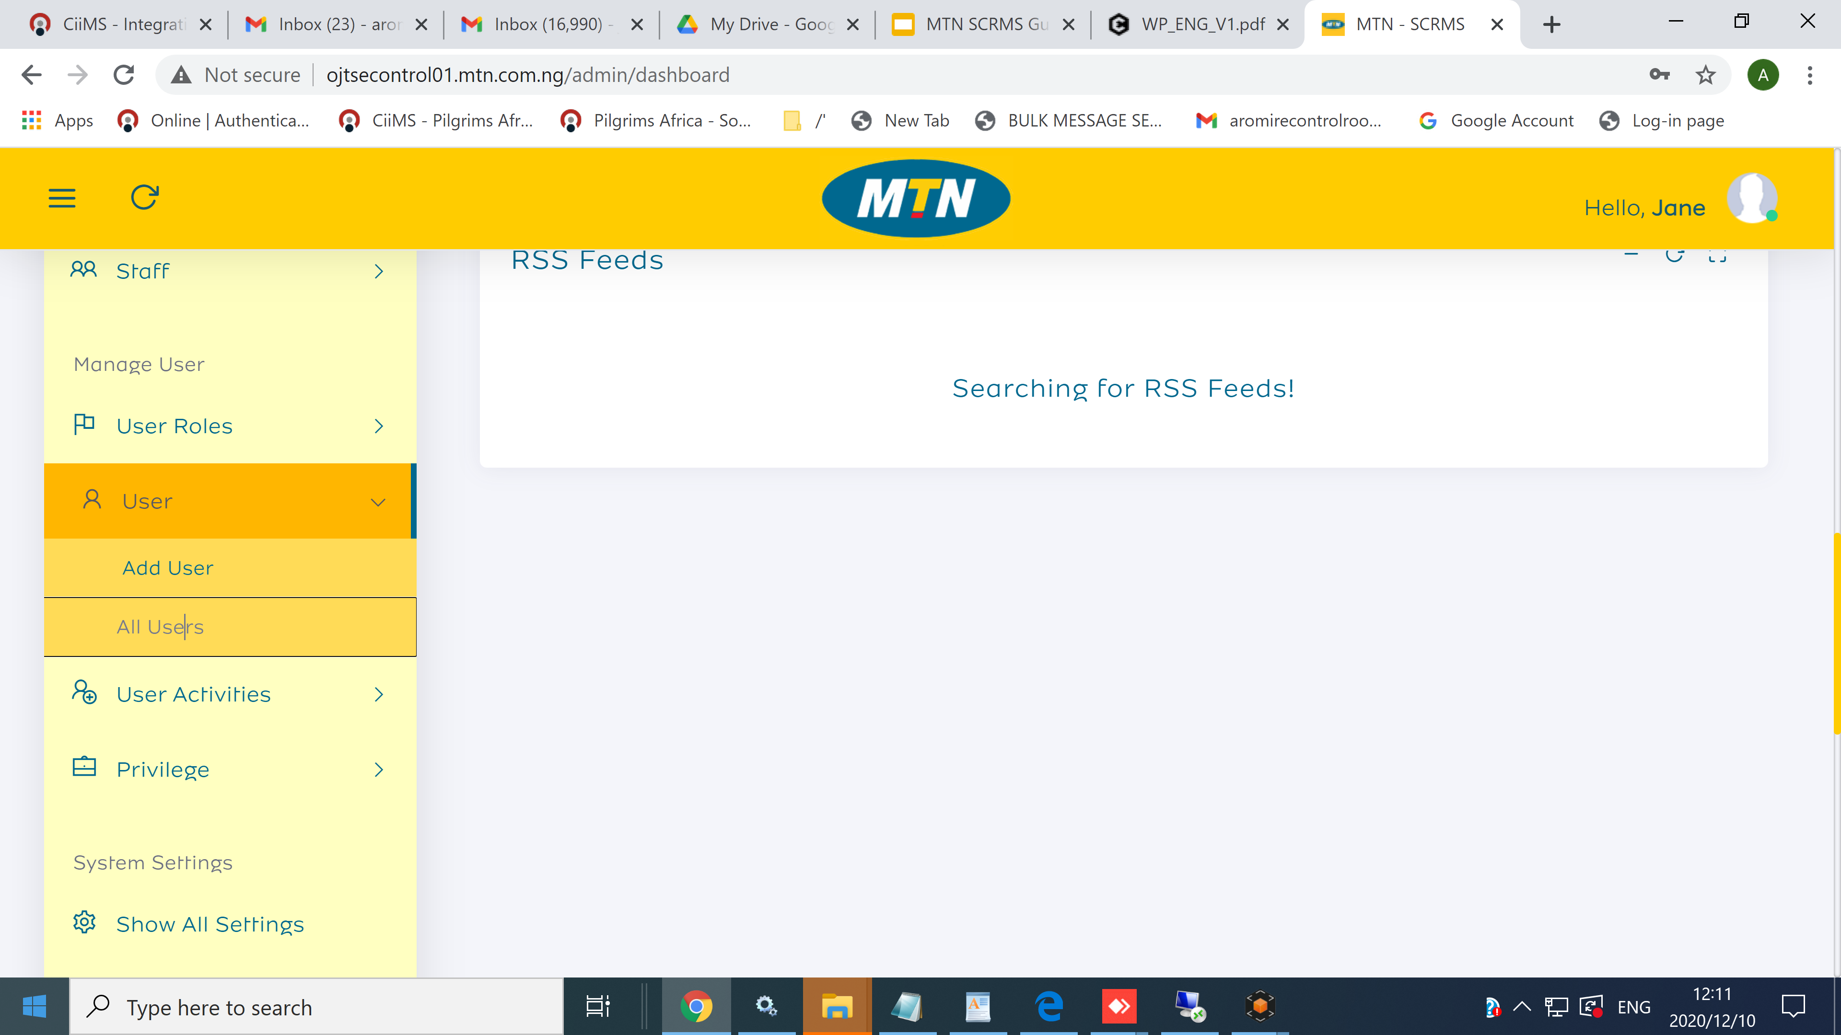
Locate “User” > 1 > “User is found in the red circle below”
Click on “Add User” to proceed.
Back to table of Contents

Slide 33
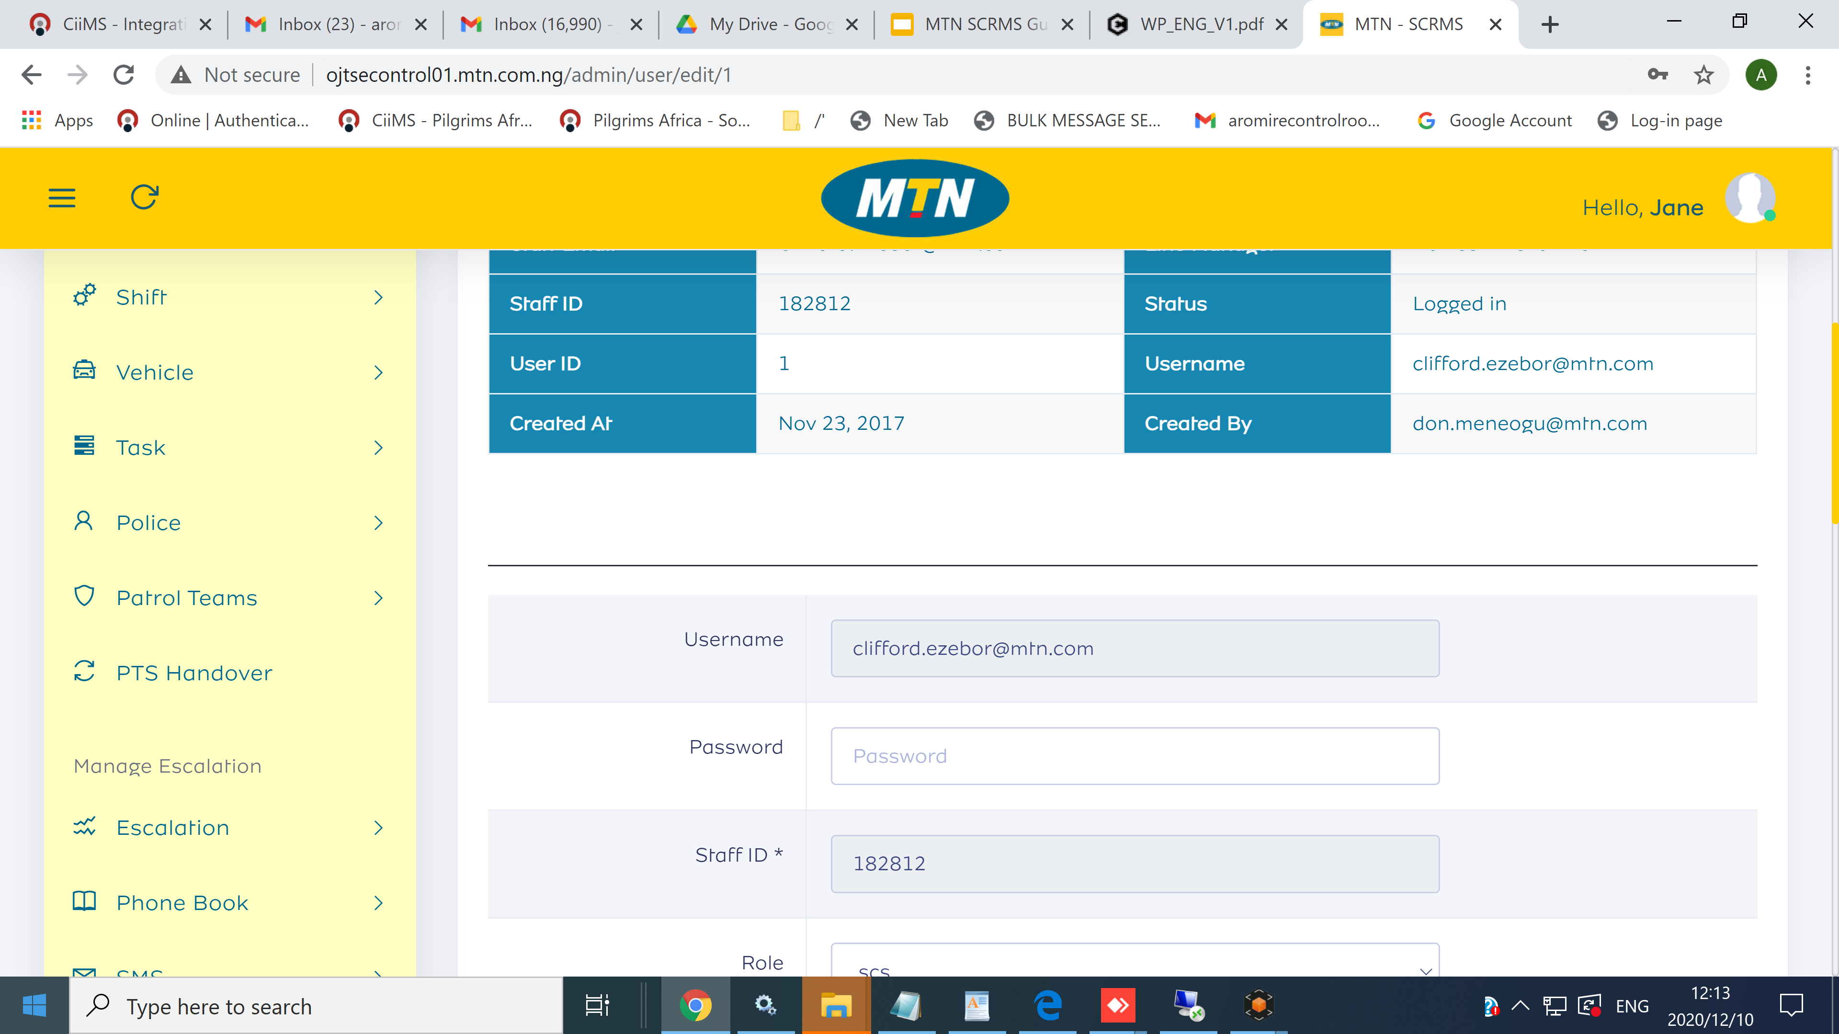
Fill the form that shows> 2 > Observe the mandatory fields
Remember to supply a password that matches the required strength
Back to table of Contents

Slide 34
View all users
Locate “user” on the menu panel and click on “All Users”
On the page that shows, use the filter to get the specific result you want
Back to table of Contents

Slide 35
Locate “User” > 1 > “User is found in the red circle below”
Click on “Add User” to proceed.
Back to table of Contents

Slide 36
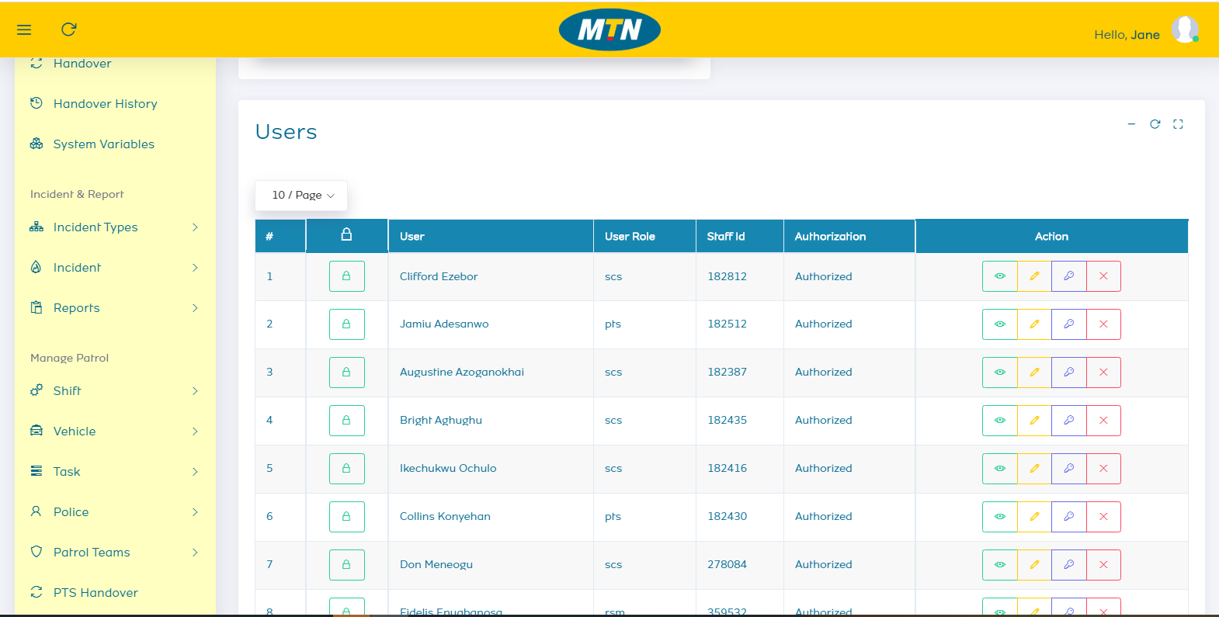
Application users are shown > 2
You can search for users or use the filters to narrow down your search
Back to table of Contents

Slide 37
View Single user
Locate “user” on the menu panel and click on “All Users”
On the user page, search for the user and click on the eagle icon to view
The user information will be shown to you
Back to table of Contents

Slide 38
Locate “User” > 1 > “User is found in the red circle below”
Click on “Add User” to proceed.
Back to table of Contents

Slide 39
Search out the user to view > 2 > Click the icon in the red oval
You can search for users or use the filters to narrow down your search
Back to table of Contents

Slide 40
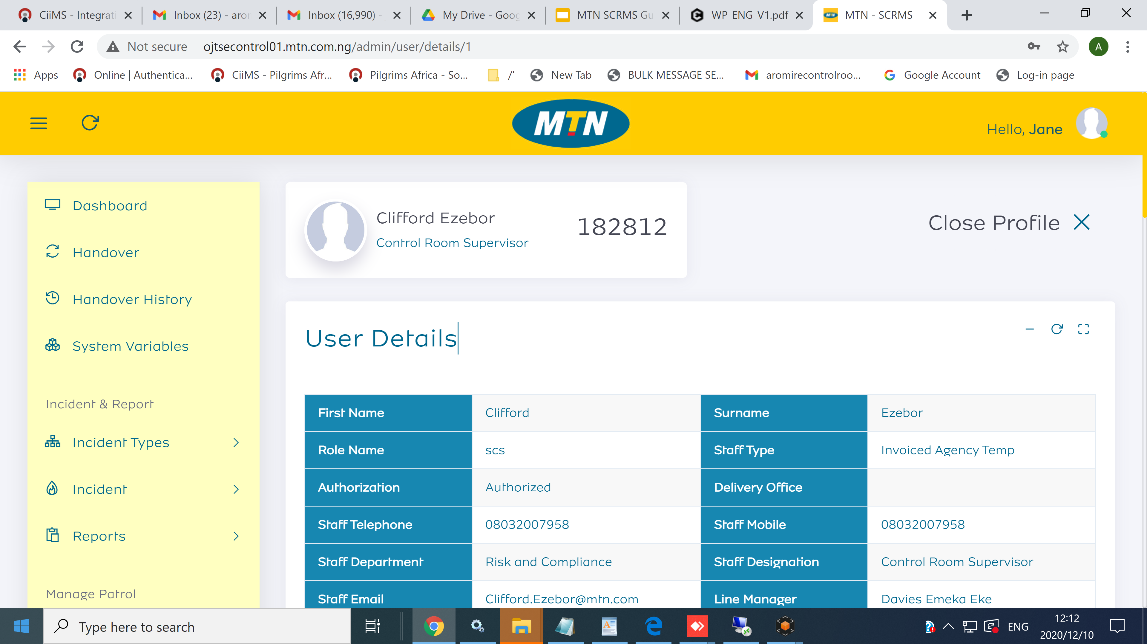
View single user > 2 > The person’s info is shown
You can search for users or use the filters to narrow down your search
Back to table of Contents

Slide 41
Shift
Click On “Add Shift”
Locate “All Shift ”
Staff in Shifts
Shift Settings{ Assign Staff to Shift }

Slide 42
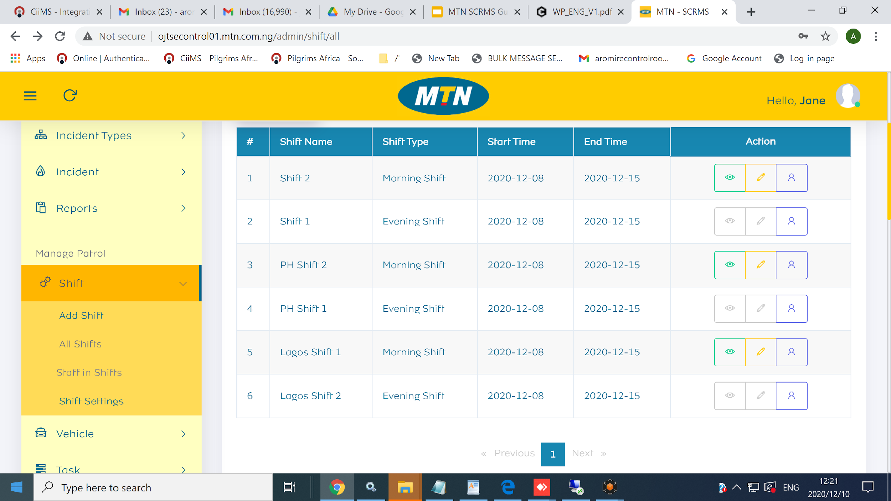
Step 2 >> Click on “ All Shifts”

Slide 43
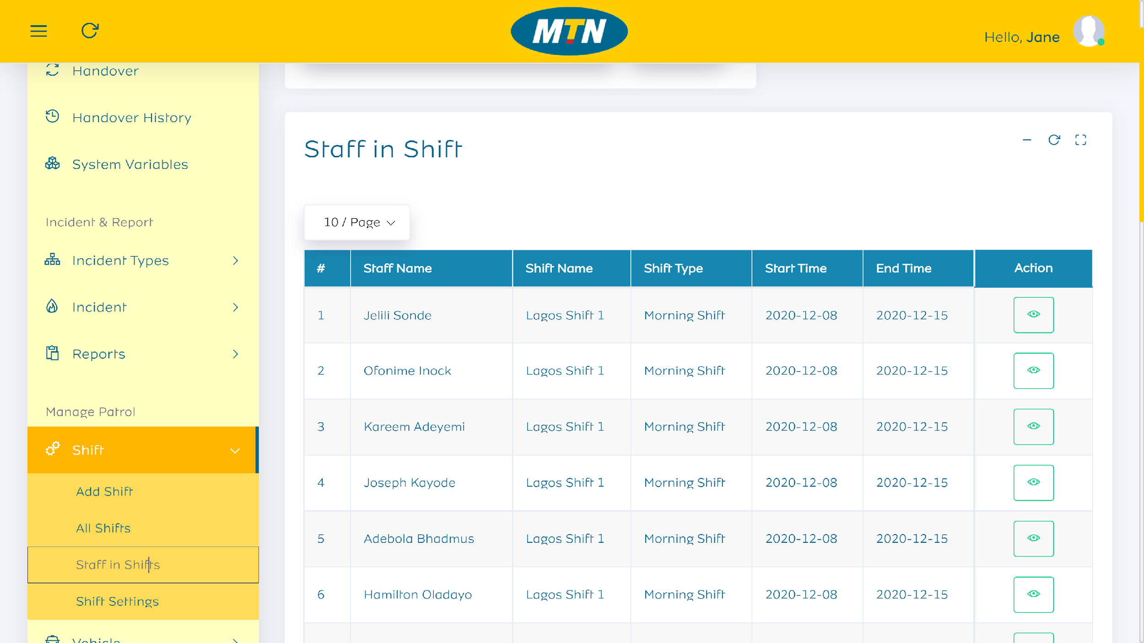
Step 3 >> Click on “ Staff in Shifts”
{
{

Slide 44
Create New Vehicle
Create Vehicle
Add Vehicle
Edit and View Vehicle
Click on “Vehicle Details”

Slide 45
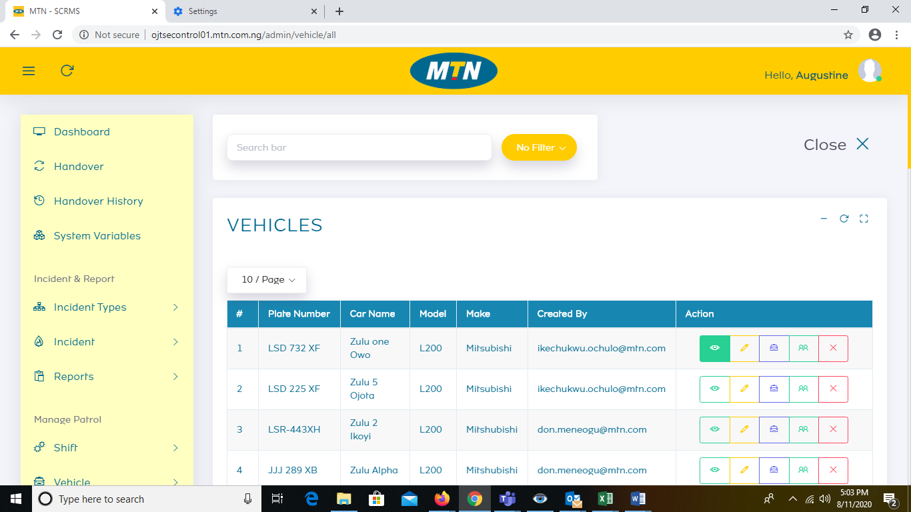
Step 1 >> “ Create Vehicles”

Slide 46
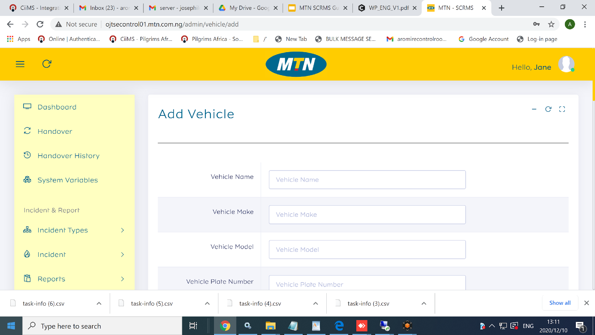
Step 2 >> “ Add Vehicles”

Slide 47
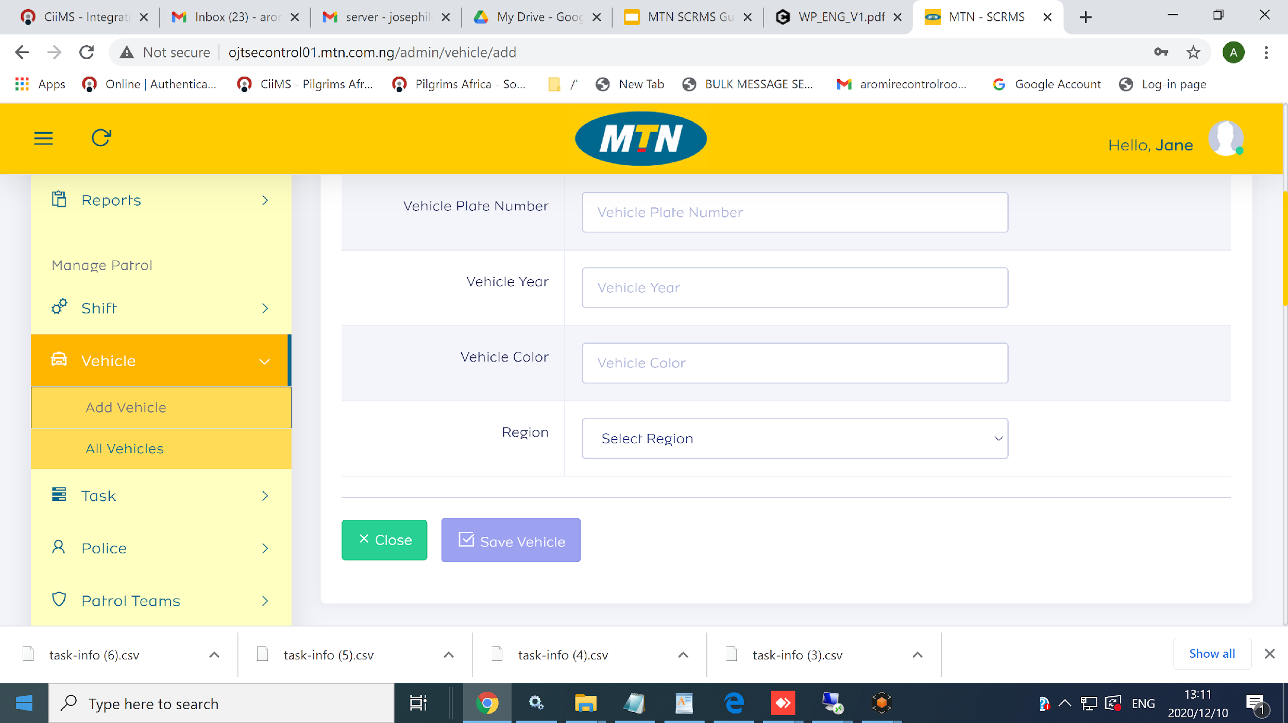
Step 3 >> “ Edit and View a Vehicles”

Slide 48
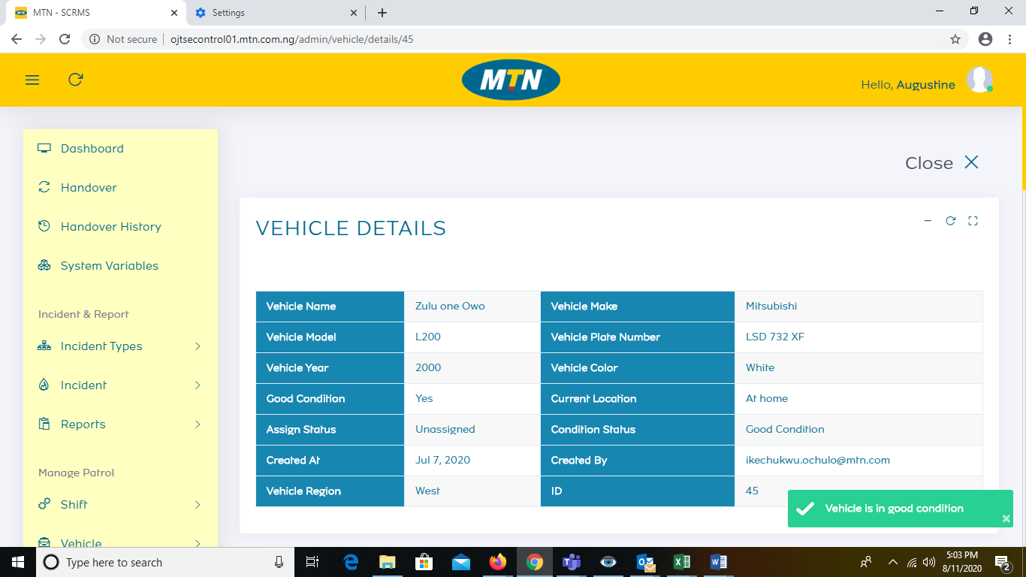
Step 4 >>Click On “Vehicle Details”

Slide 49
Police
Click On “Add Police”
Create Police
View All “Police”
View and Edit a Police Details

Slide 50

Step 1 >> “ Click On Add Police”

Slide 51
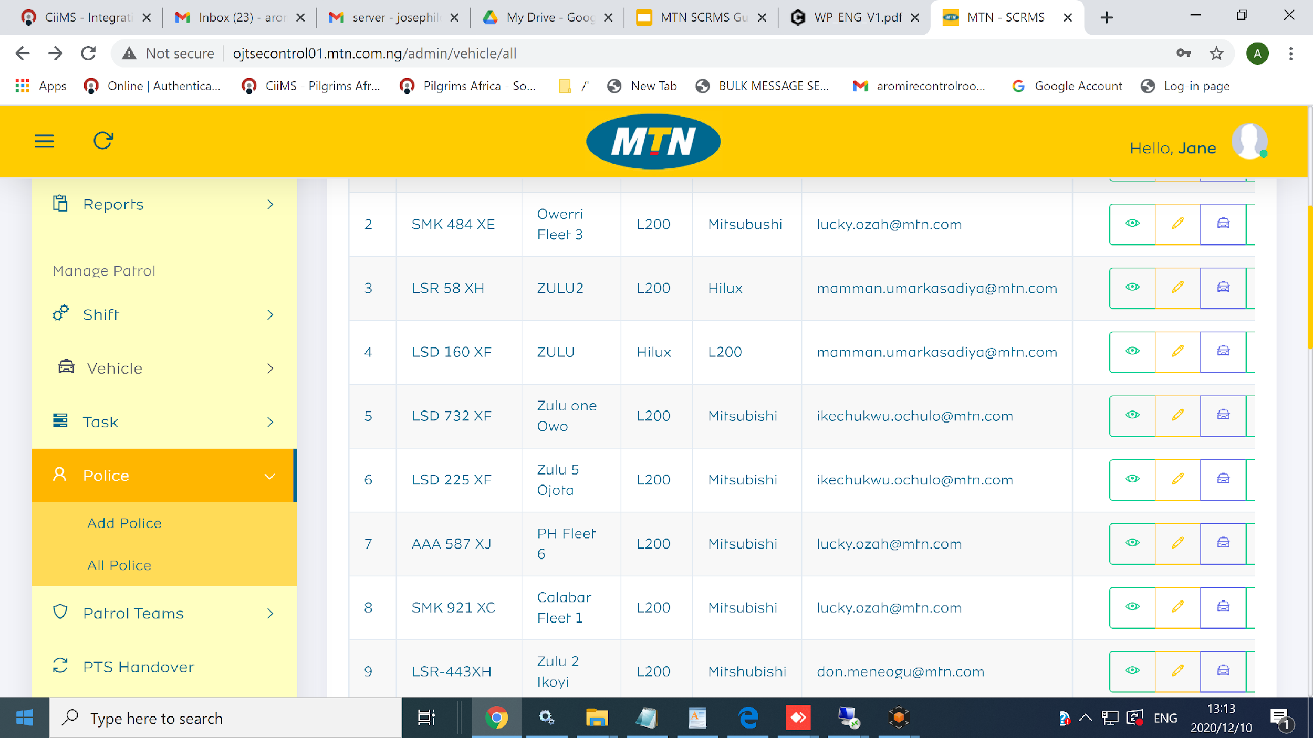
Step 2 >> “ Create Police”

Slide 52
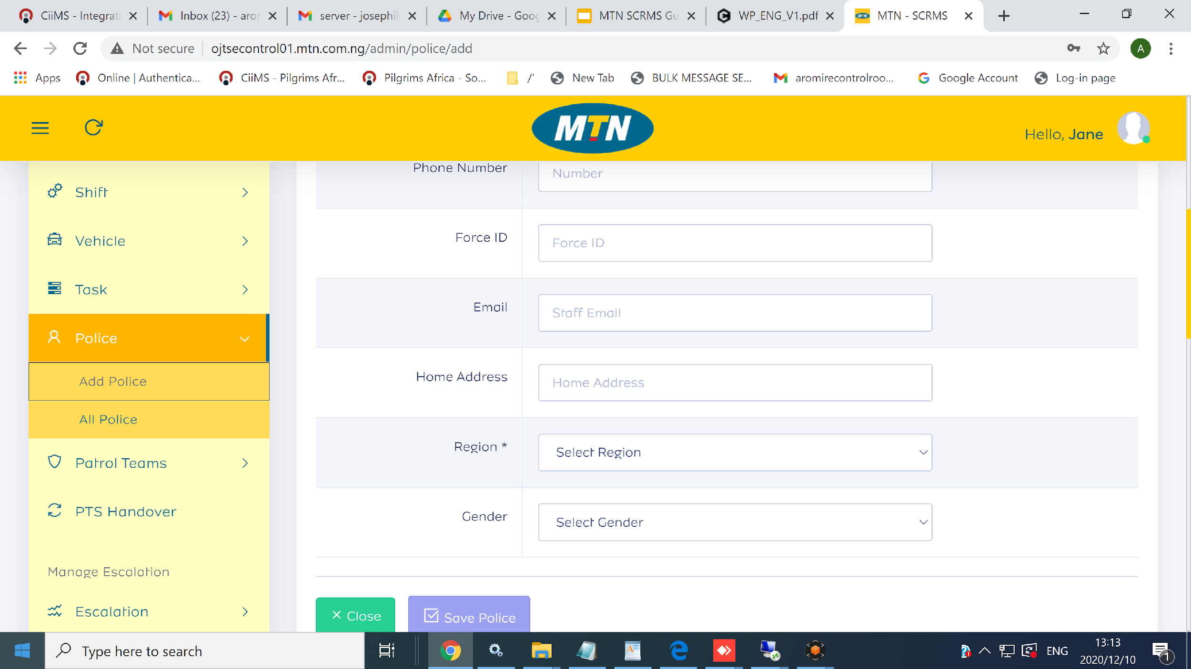
Step 3 >> “ View All Police”

Slide 53
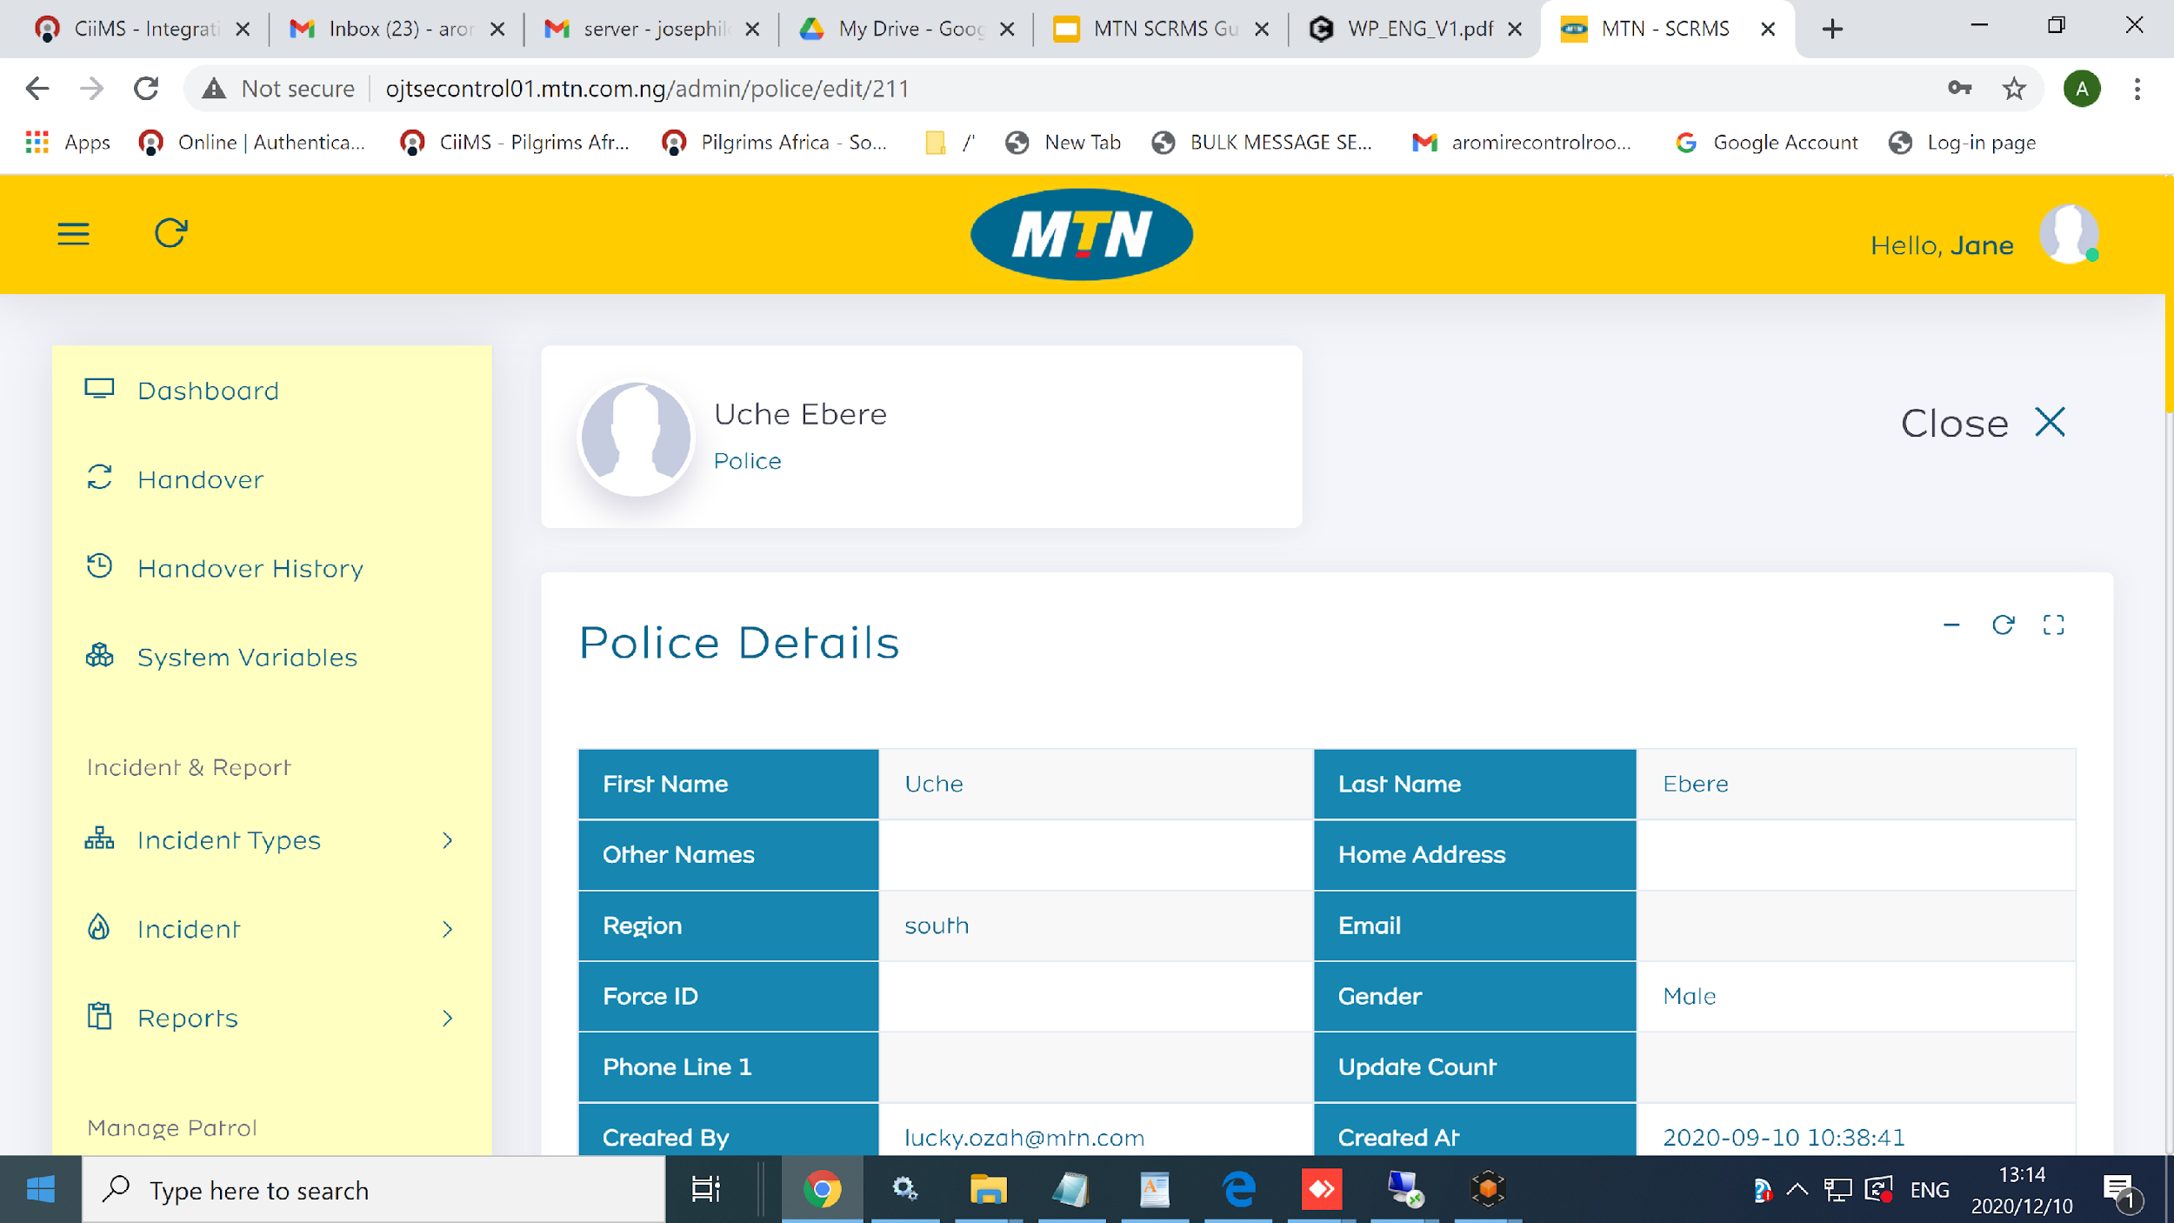
Step 4>> “ Viewand Edit a Police Details”

Slide 54
Patrol Team
Click On “Add Patrol Team”
Create Patrol Team
View All “Patrol Team”
View and Edit a Patrol Team

Slide 55
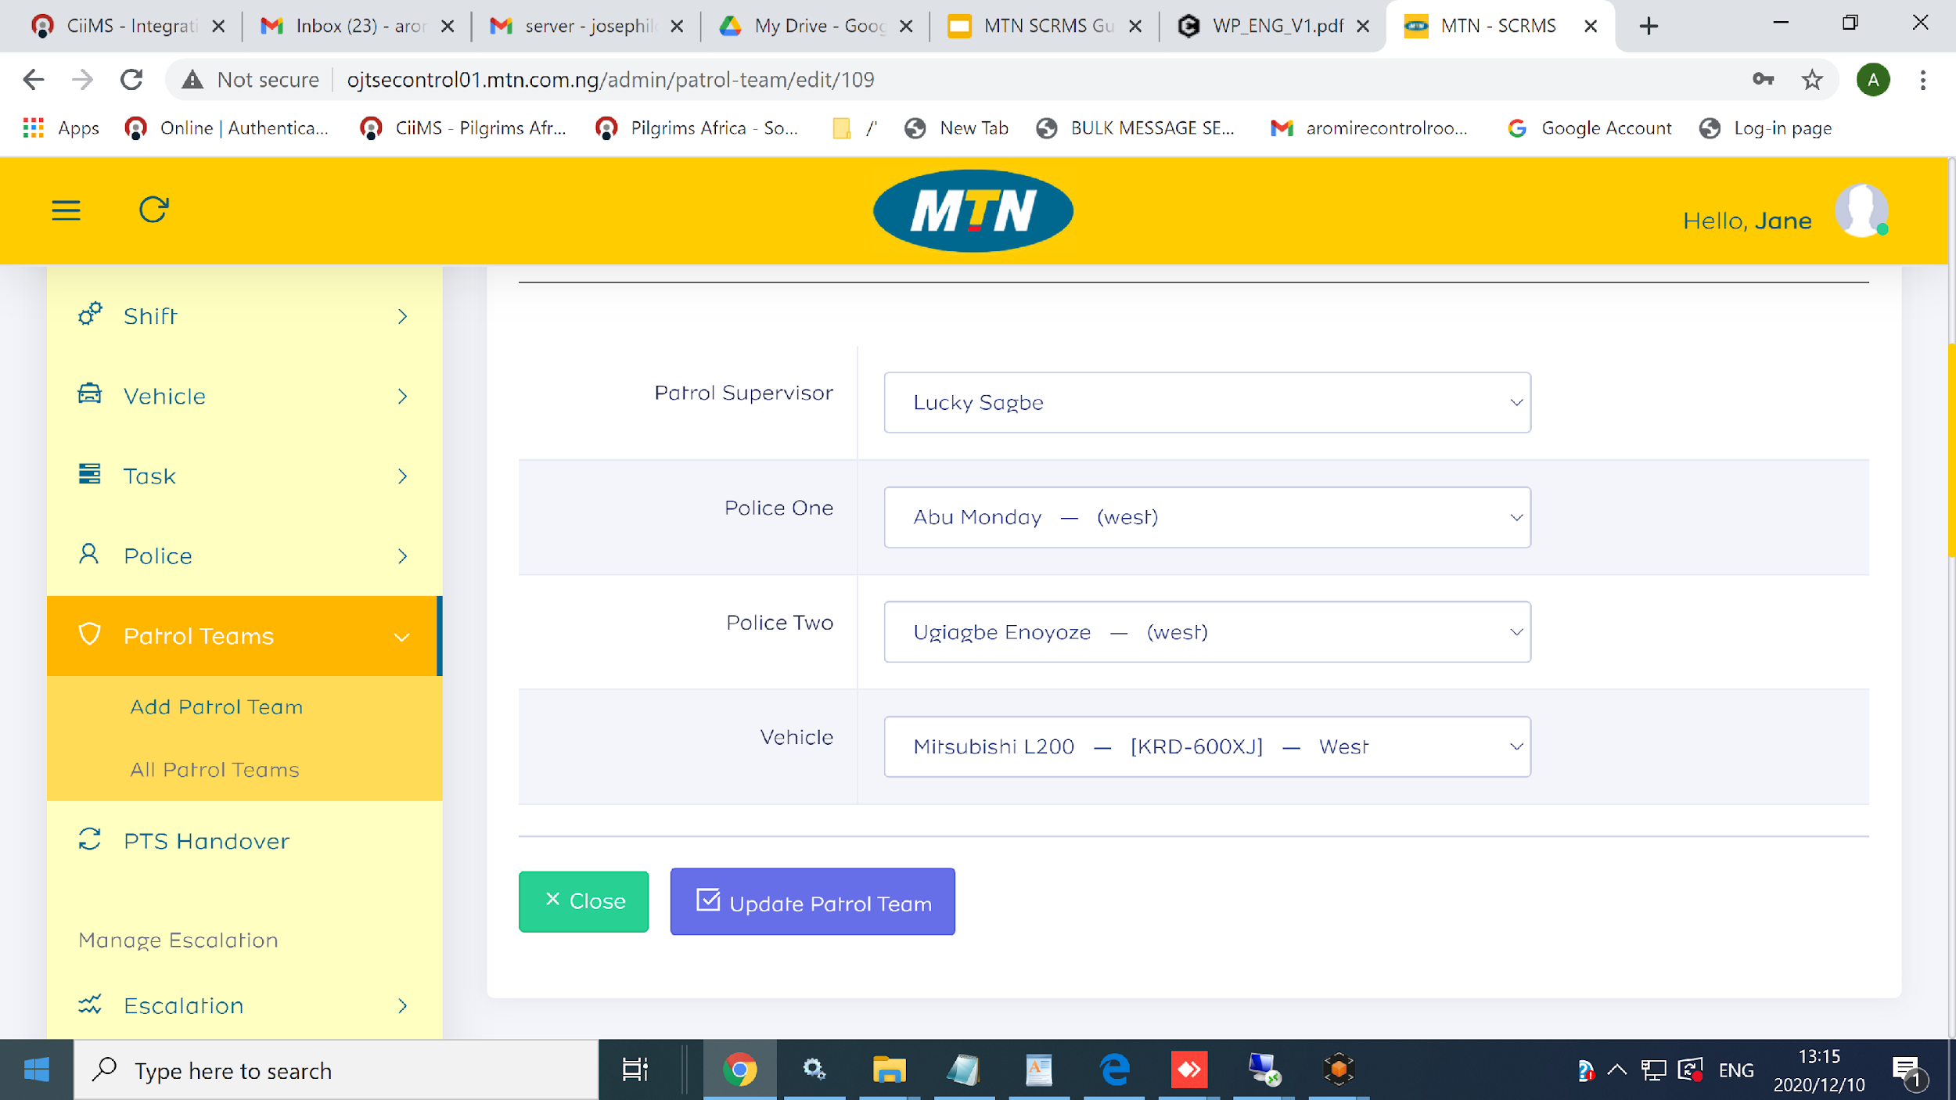
Step 1 >> “ Click On Add Patrol Team ”

Slide 56
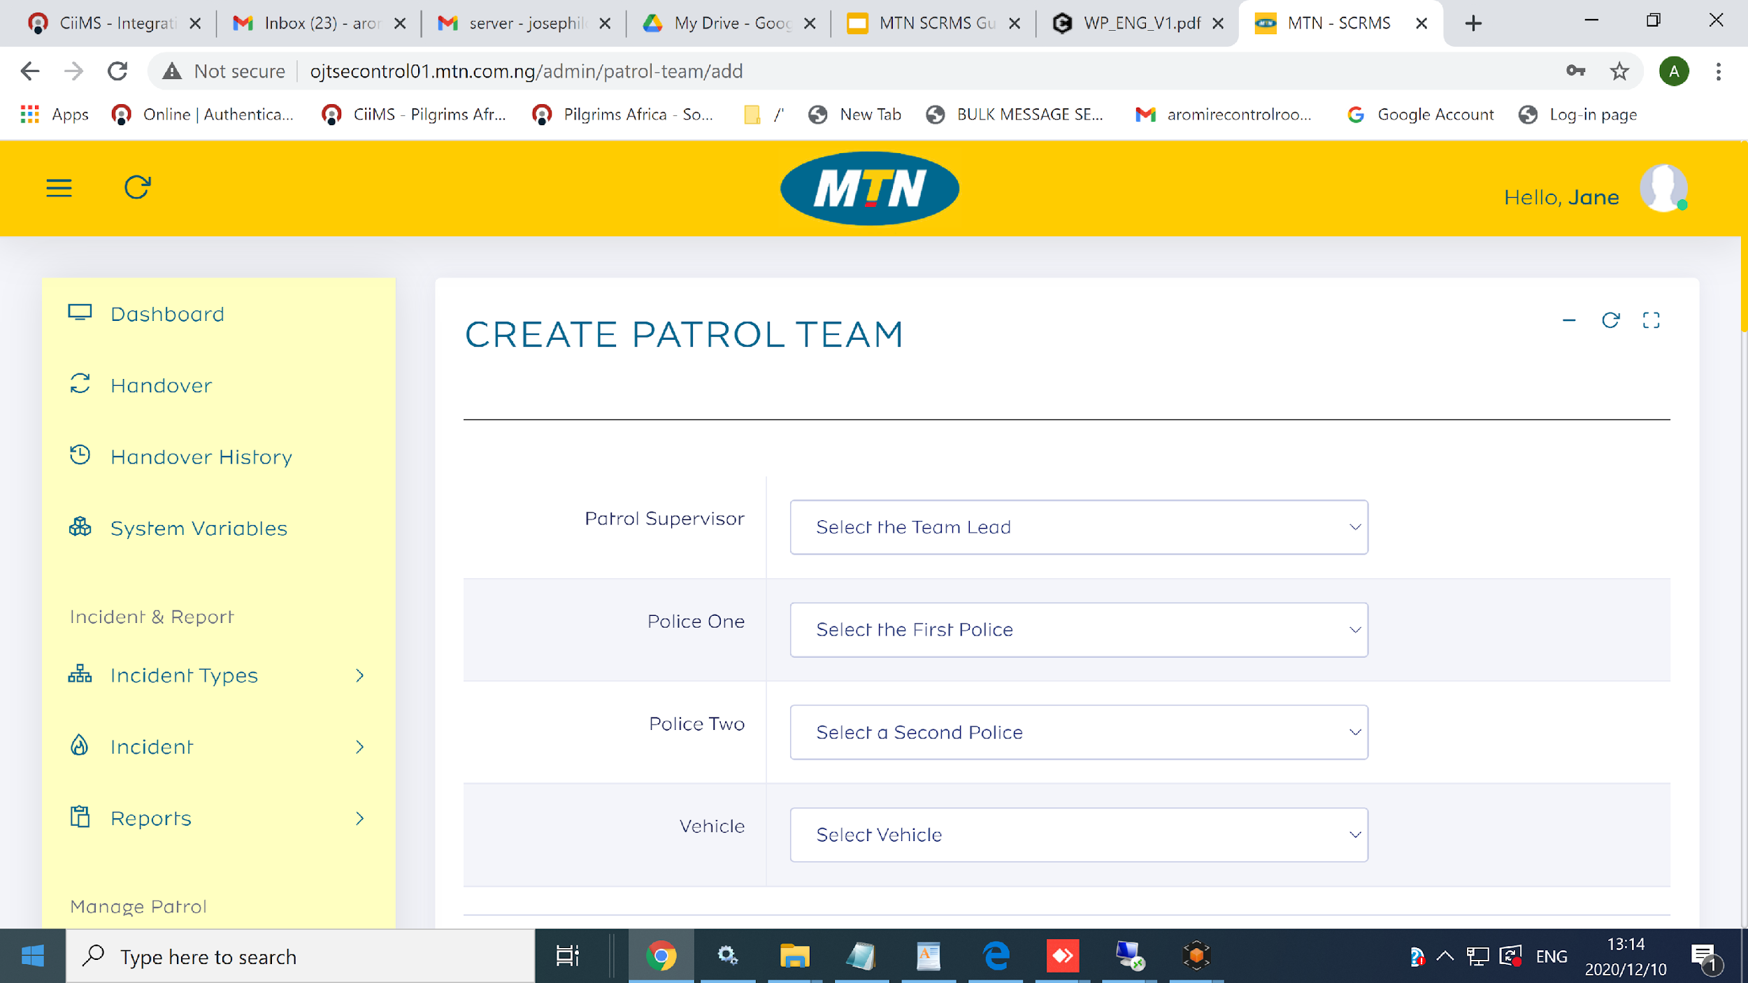
Step 2 >> “ Create Patrol”
{
{

Slide 57
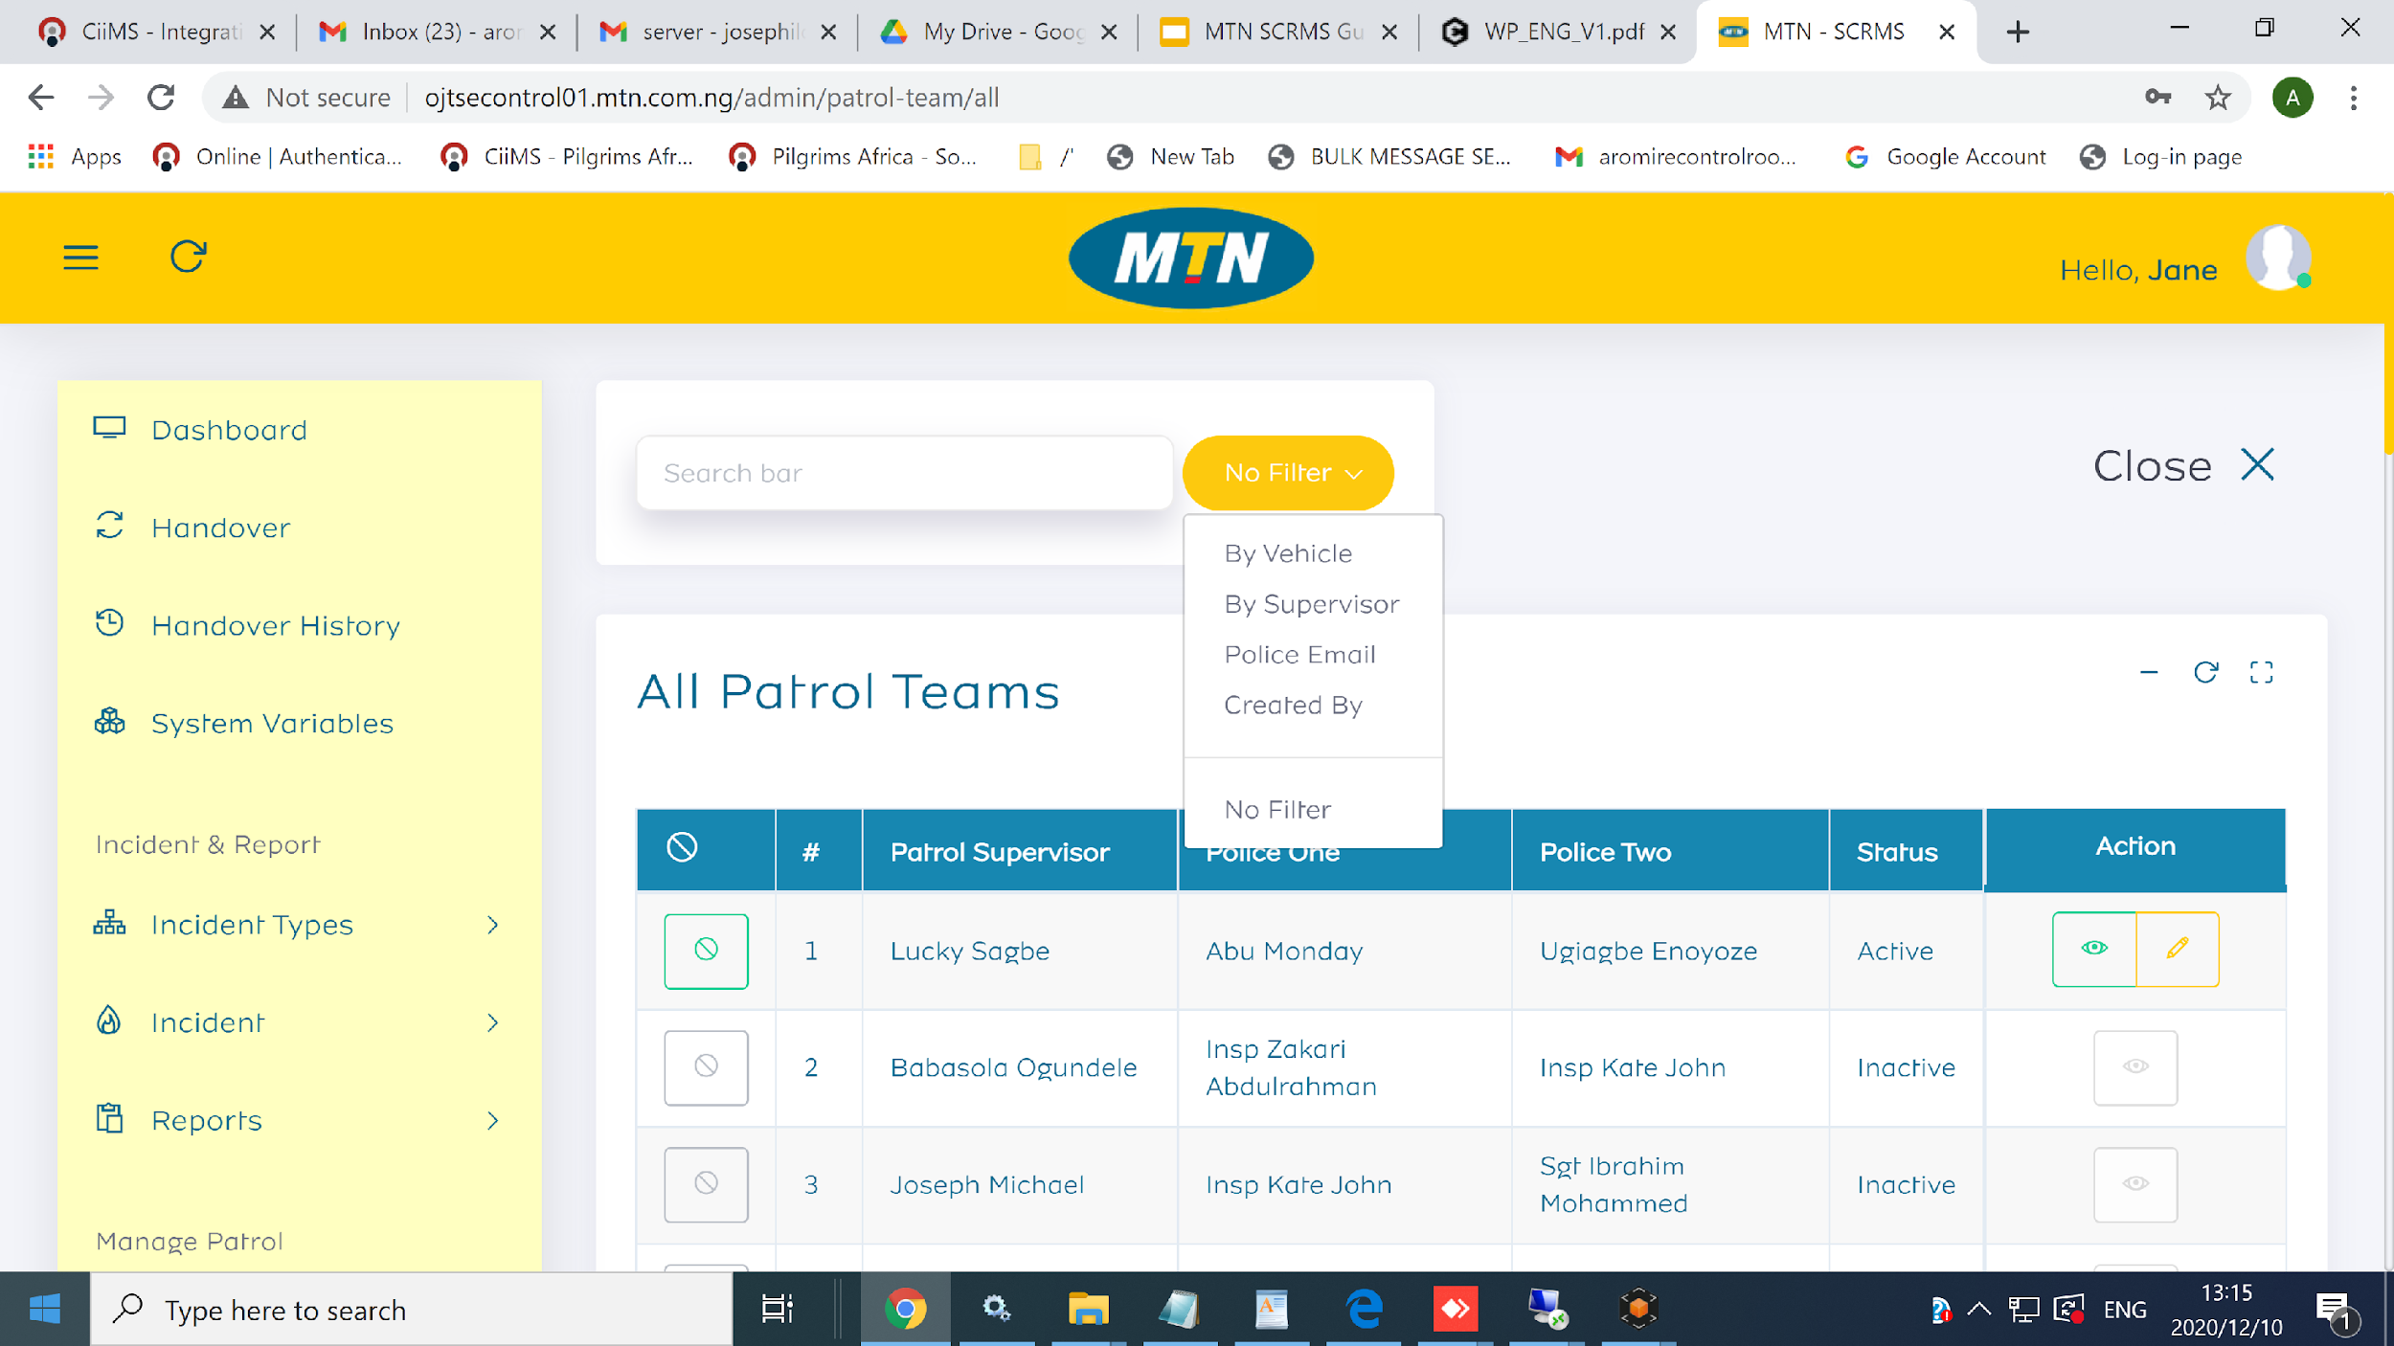
Step 3 >> “ View All Patrol Team”
{
{

Slide 58
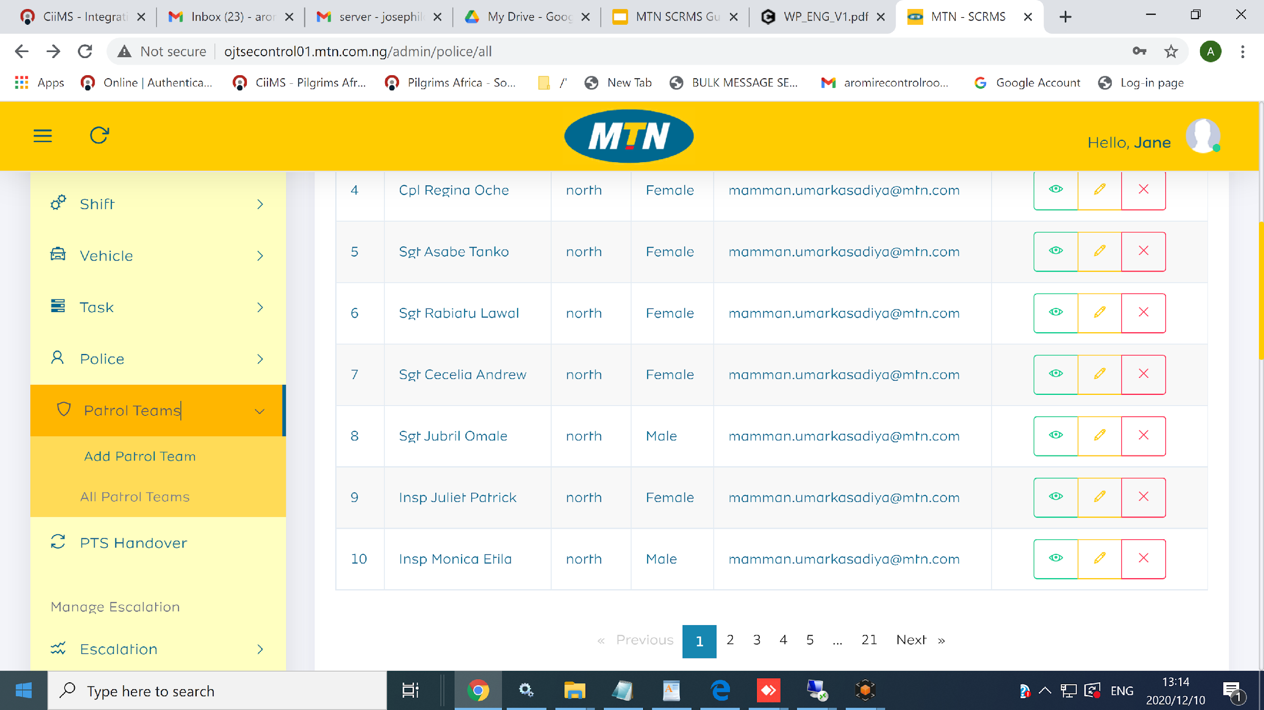
Step 4 >> “ View and Edit A Patrol Team”

Slide 59
Escalation Level
Create Escalation List
Escalation By Self Settings
Escalation On Behalf of Email Template
Incidents Escalation by Self Notification Template

Slide 60
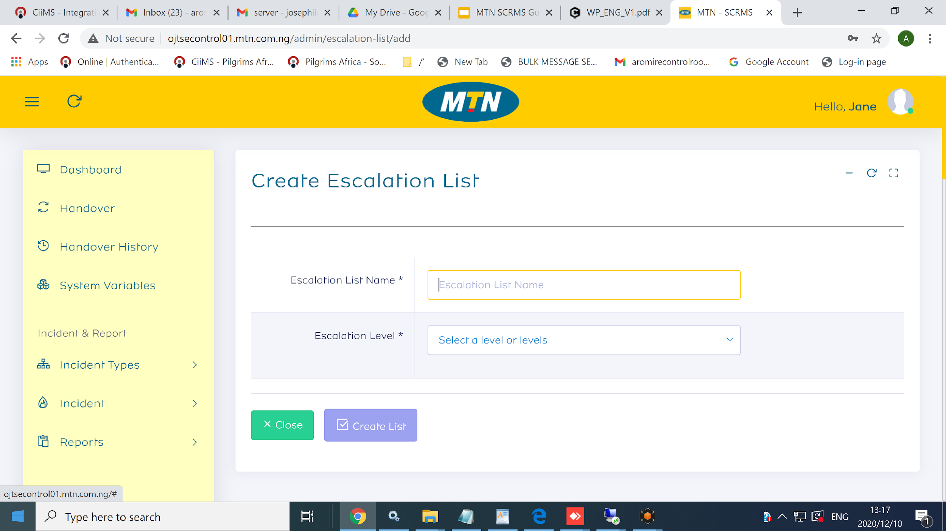
Step 1 >> “Create Escalation List”
{
{

Slide 61
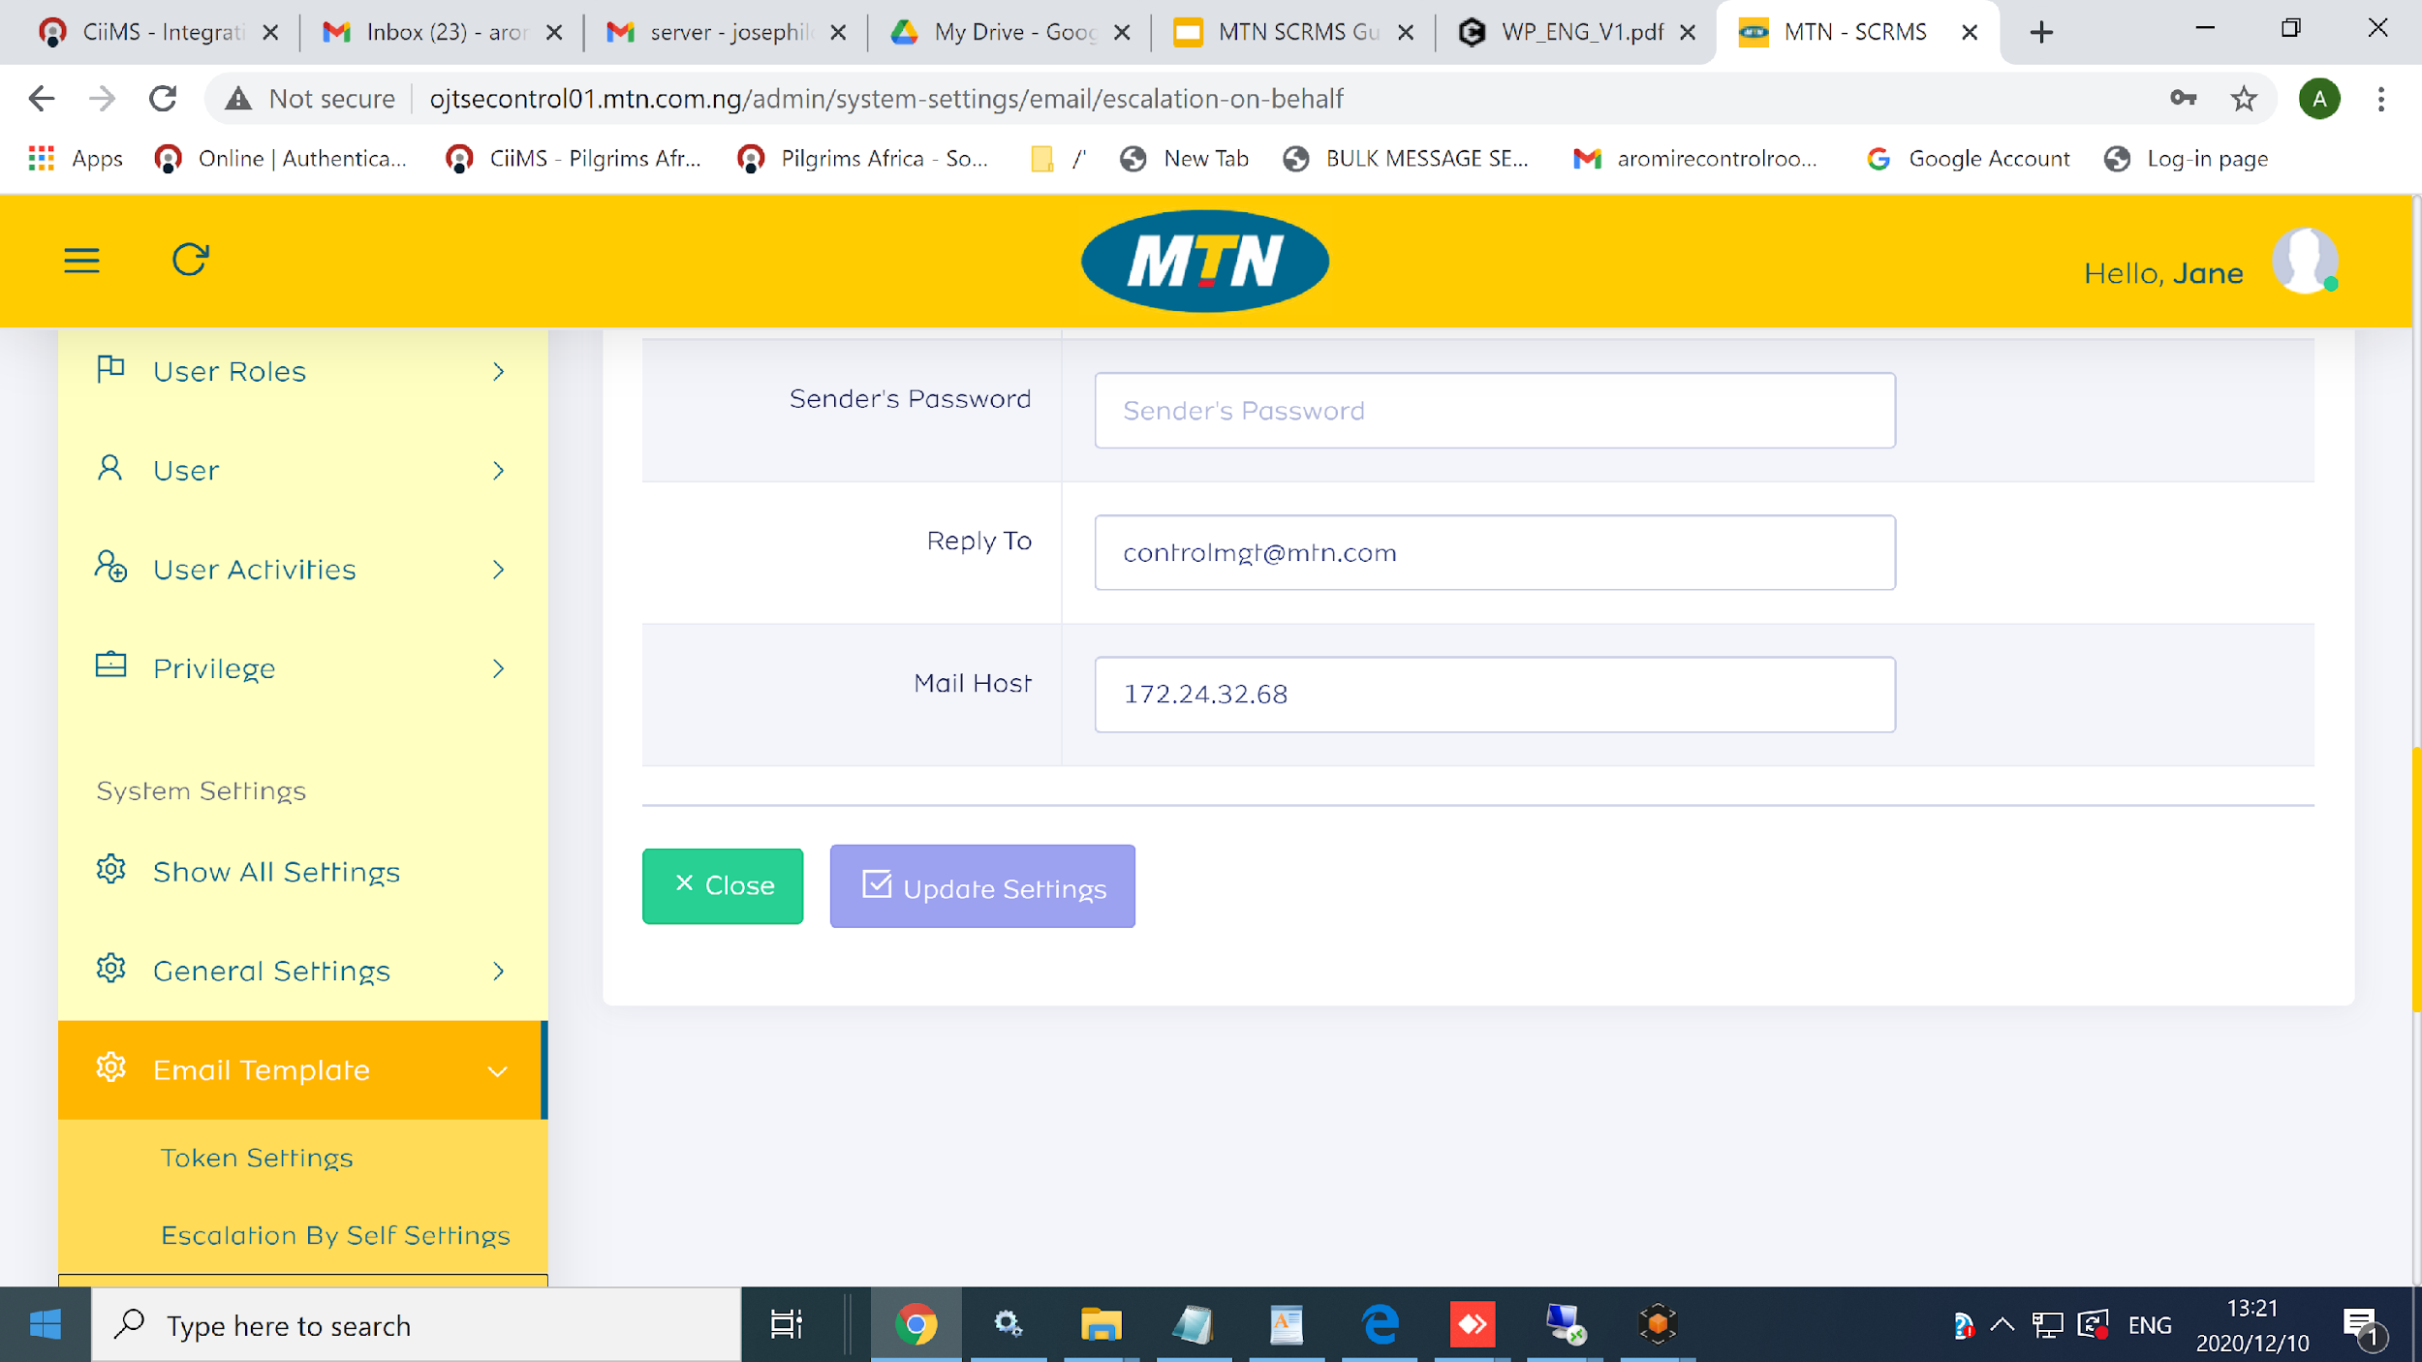
Step 2 >> “ Escalation By Self Settings”

Slide 62
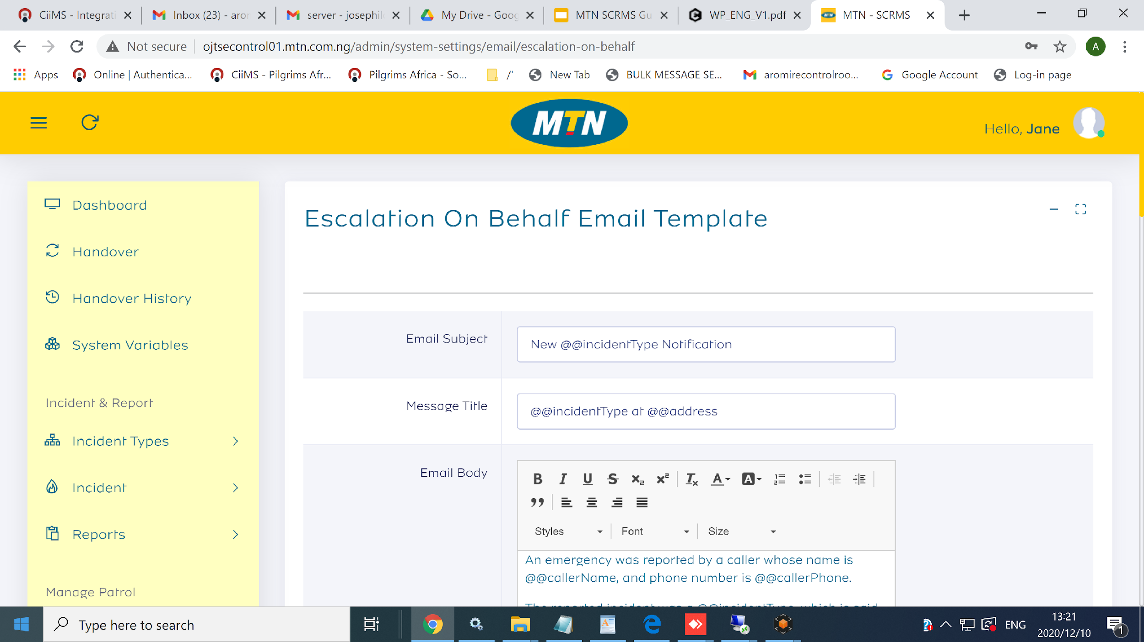
Step 3 >> “ Escalation on Behalf Email Template ”
{
{

Slide 63
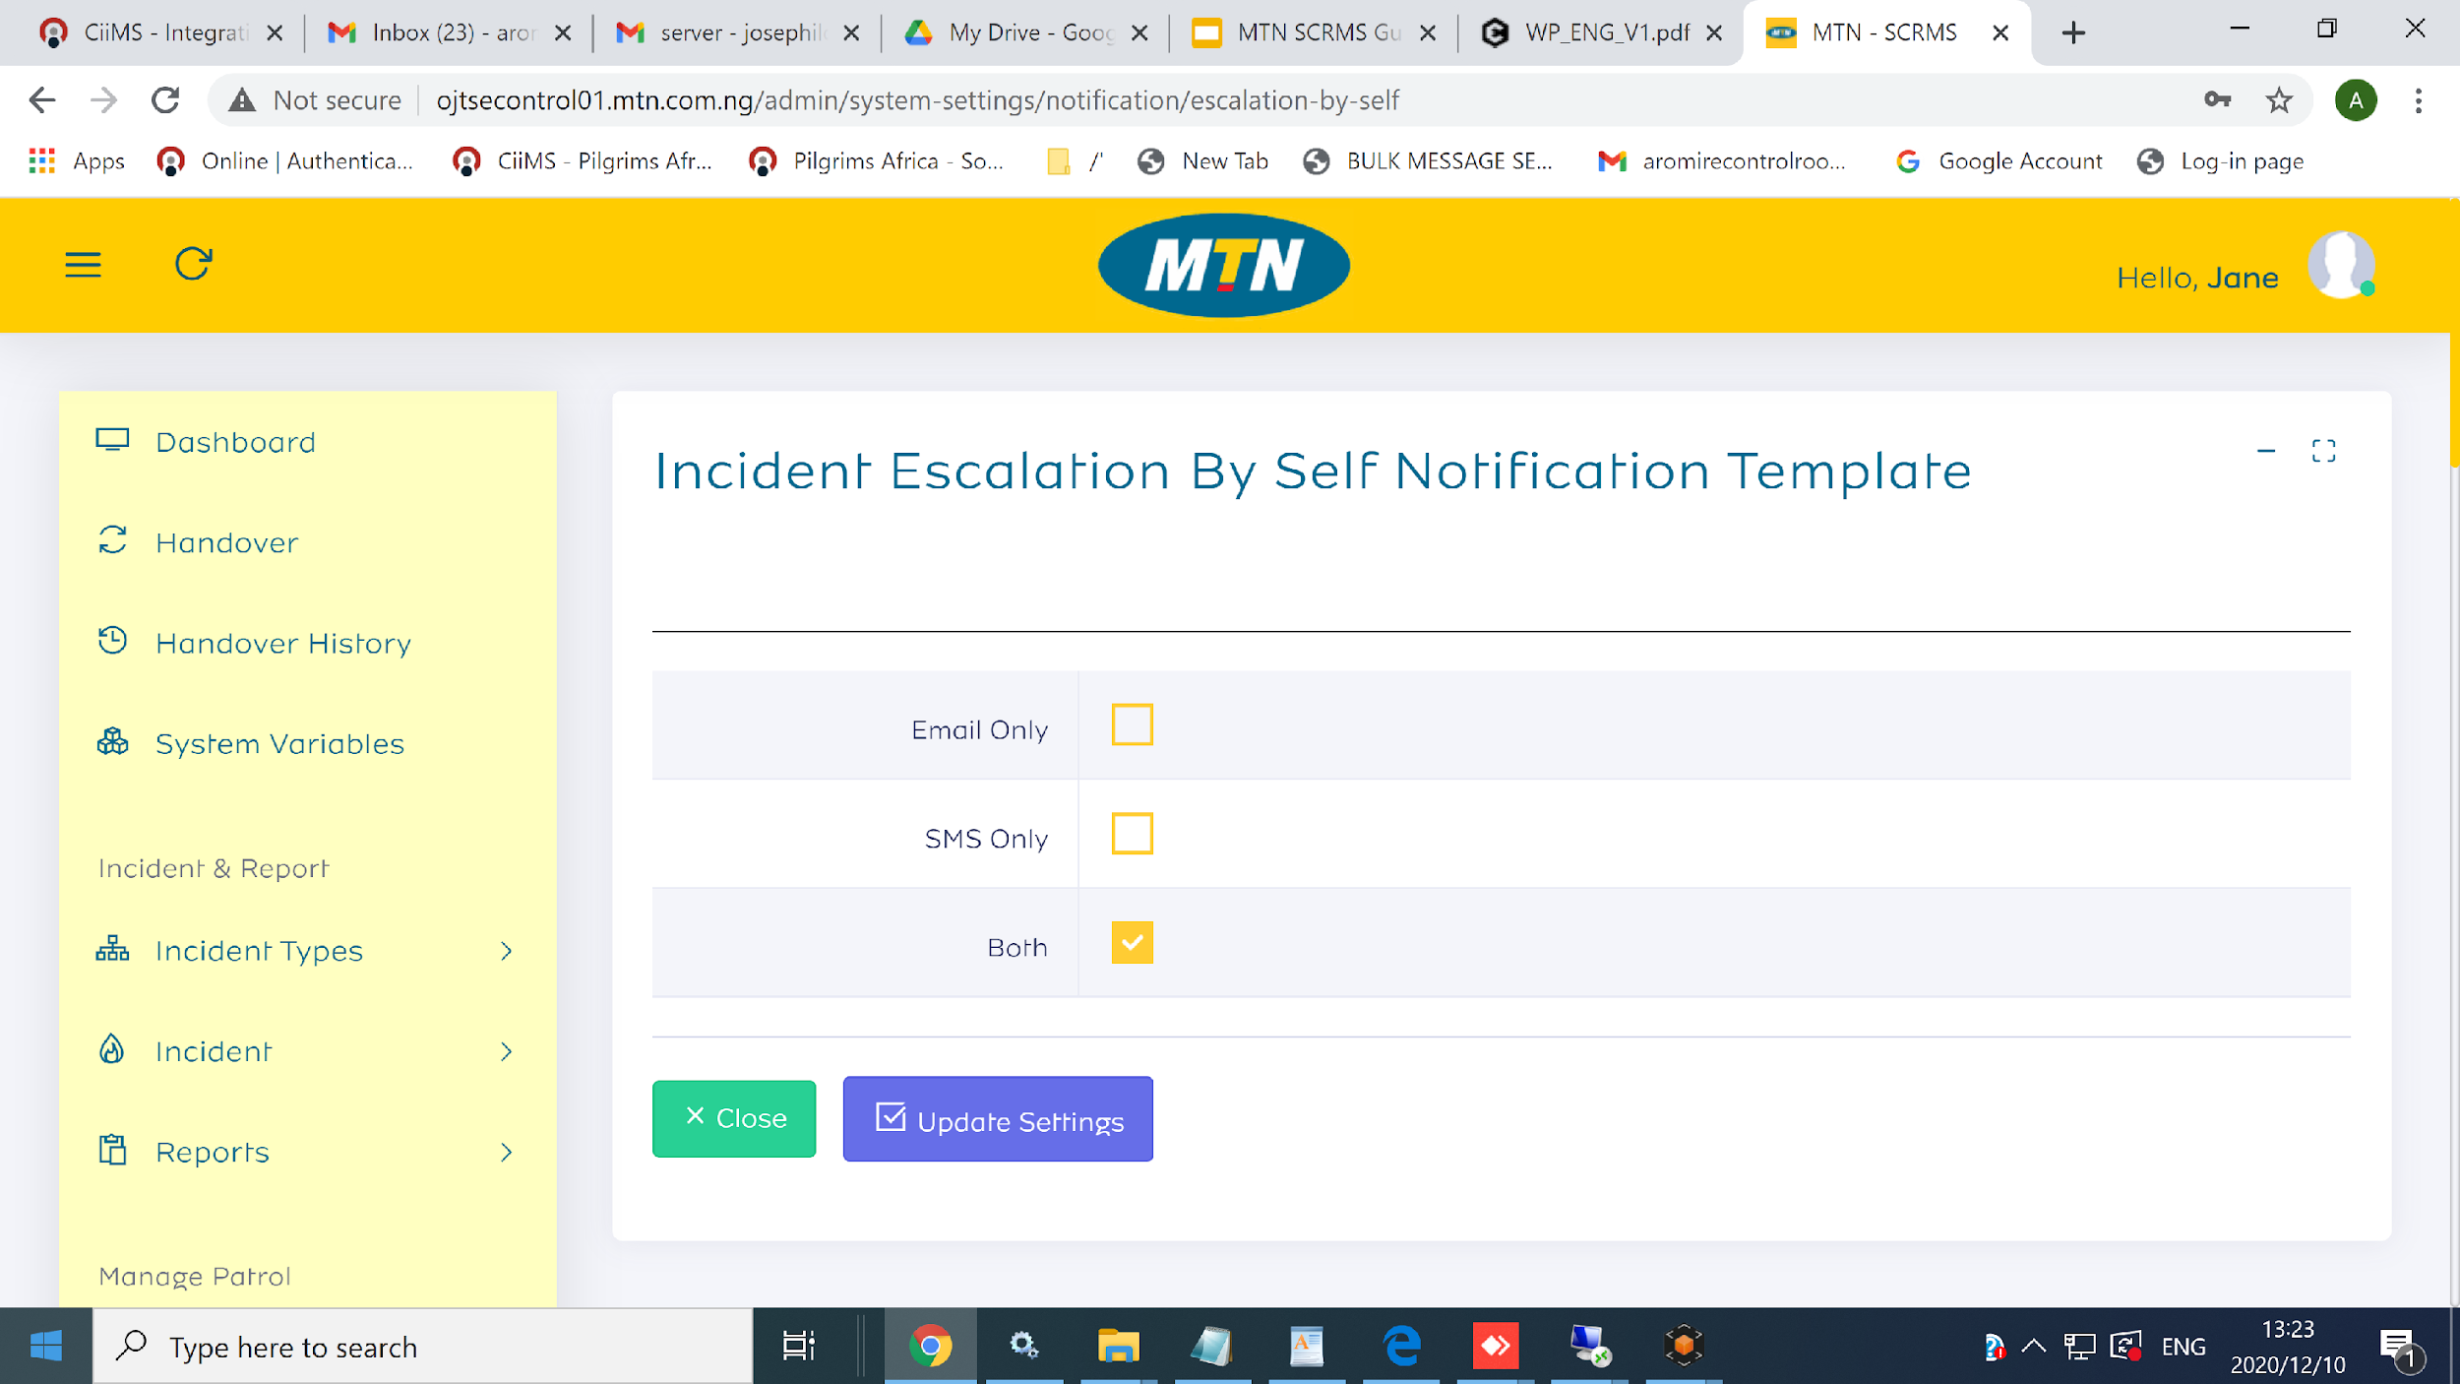
Step 4 >> “Incident Escalation ”
{
{

Slide 64
Incident type
Click on “Add Incident Type
Locate “All Incident Type
Report Incident
Update Incident

Slide 65
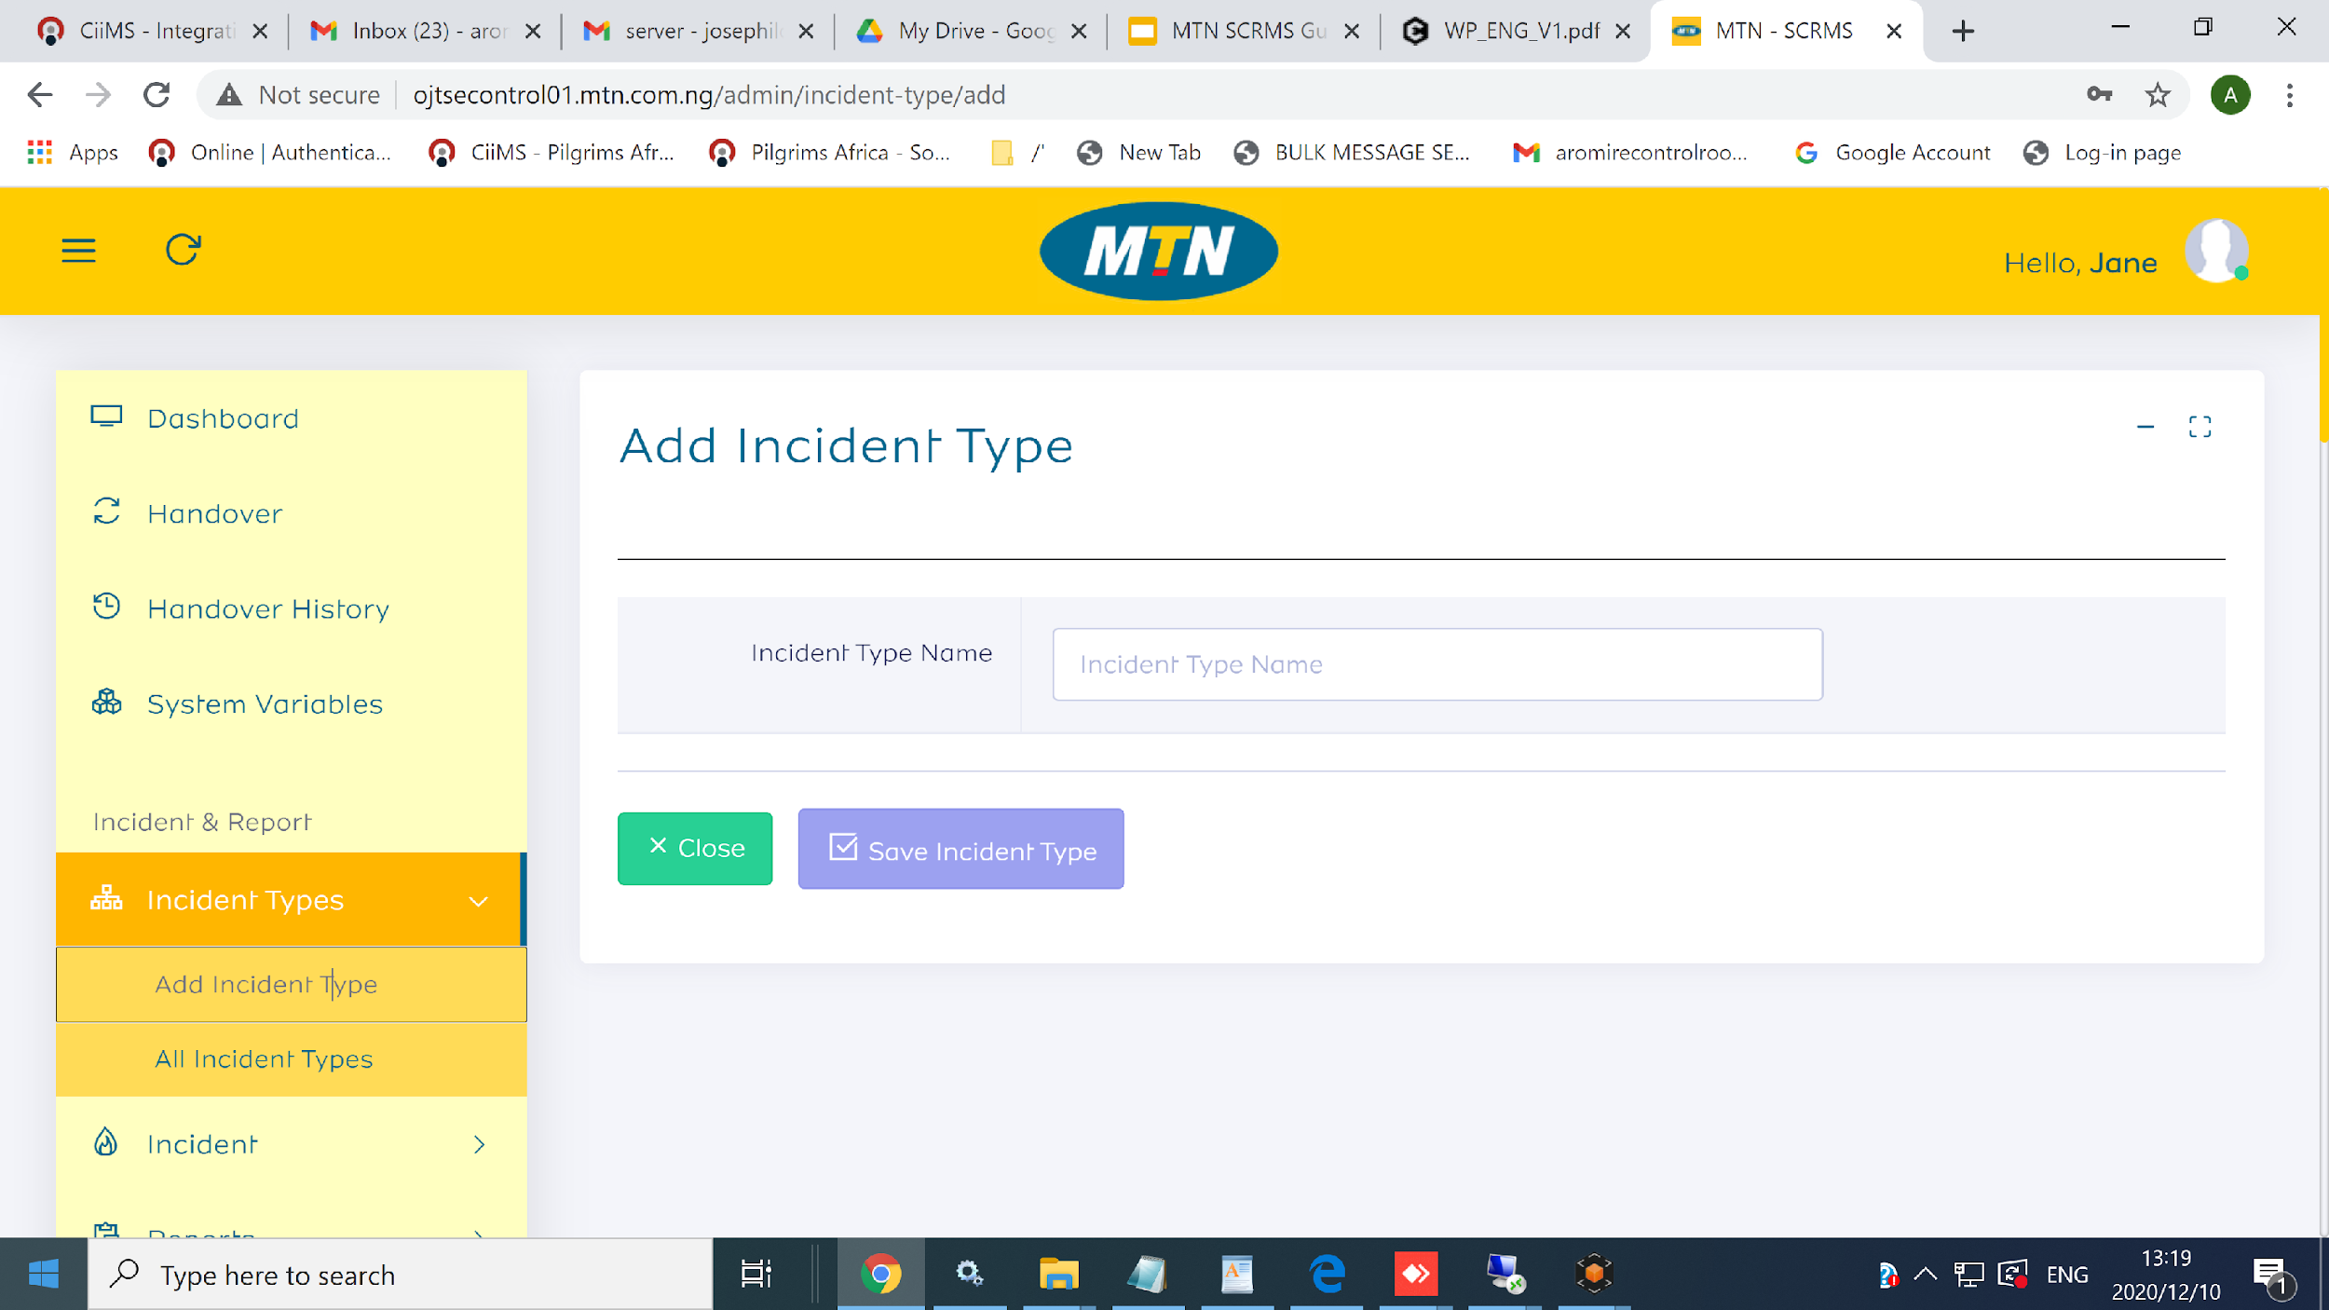
Step 1 >> Click On “ Add Incident Type ”
{
{

Slide 66
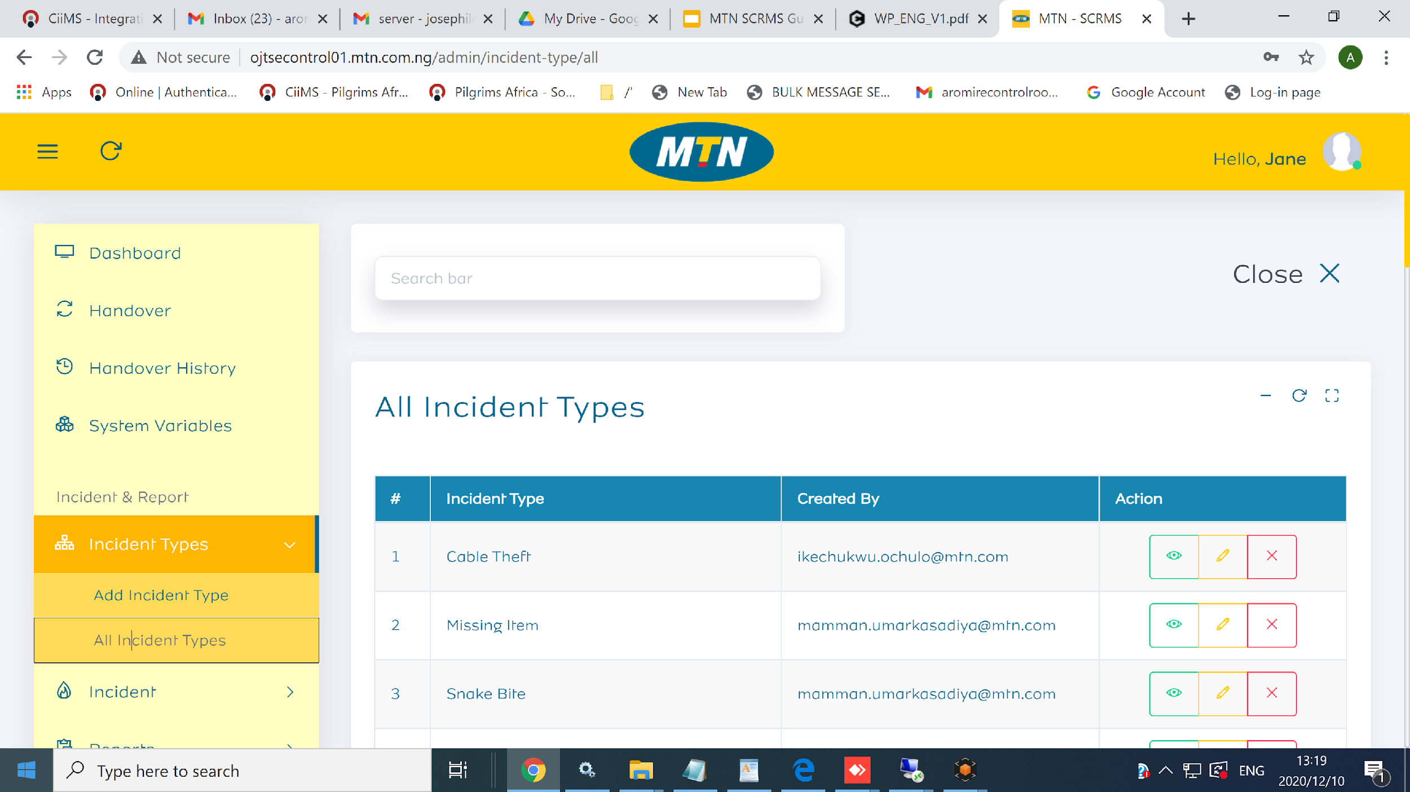
Step 2 >> Locate “ All Incident Type ”
{
{

Slide 67
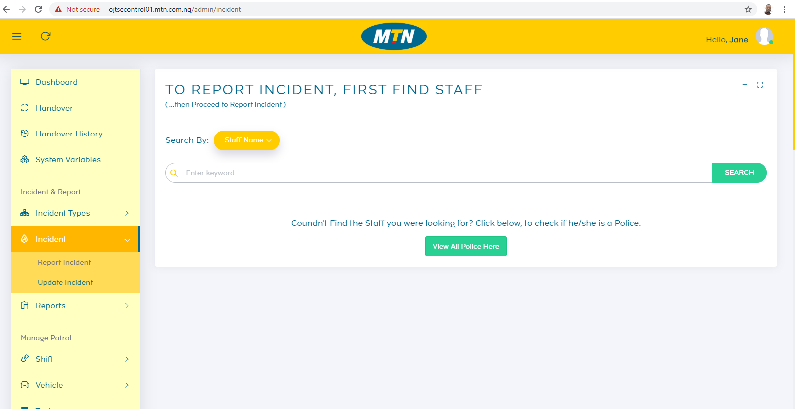
Step 3>> Locate “ Report Incident ”

Slide 68
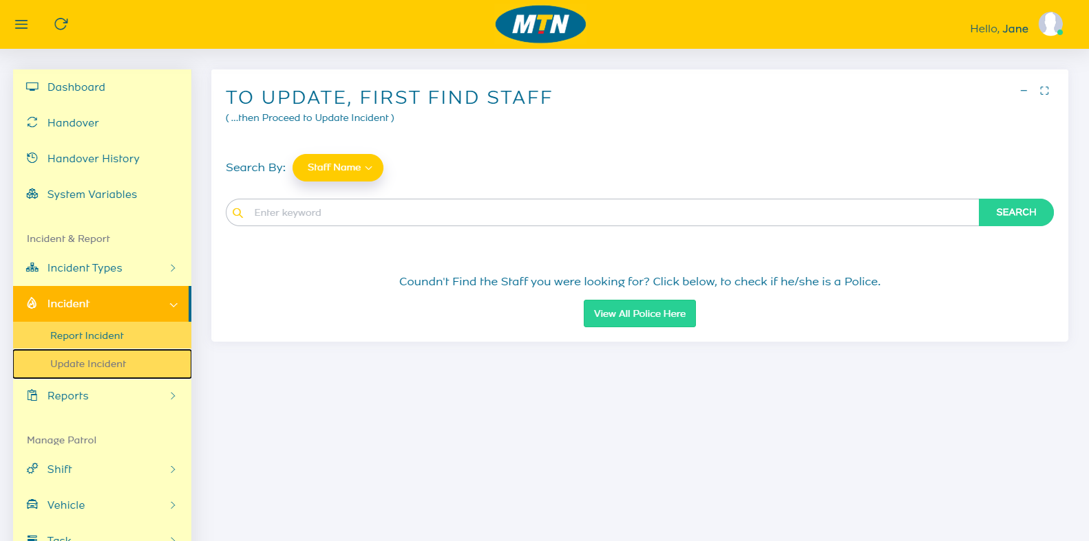
Step 4 >> Locate “ Update Incident ”

Slide 69
5.
Task Management

Slide 70
Task Management
Create an Escort Task
View all task
View and Edit a task Information
Start a Task
Complete a Task
Return a Vehicle after task Complete
Reassign a Task
Cancel a Task
Reopen a Canceled Task

Slide 71
6.
Incident Management

Slide 72
Report an Incident
View all reported Incident
View and edit a incident record
Close an Incident
Reopen an Incident

Slide 73
7.
Reports

Slide 74
Locate “Task Report”
Click on “Incident Report”

Slide 75
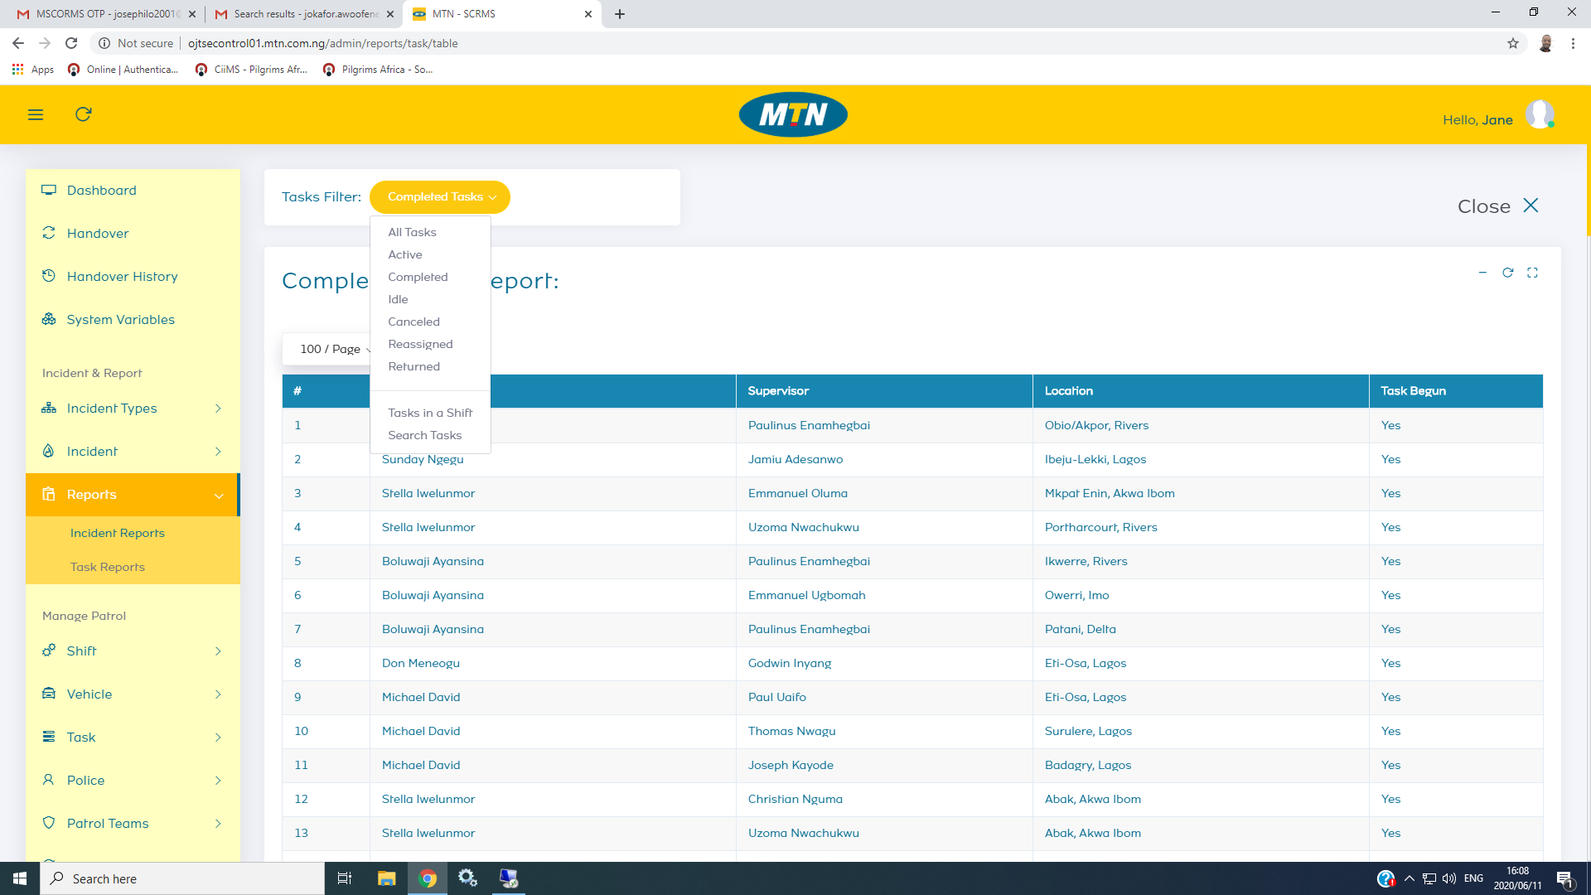
Step 1>> Locate “Task Report ”

Slide 76

Step 1>> Locate “Task Report ”

Slide 77
8.
Handover

Slide 78
Handover
Handover Responsibility
Handover history

Slide 79
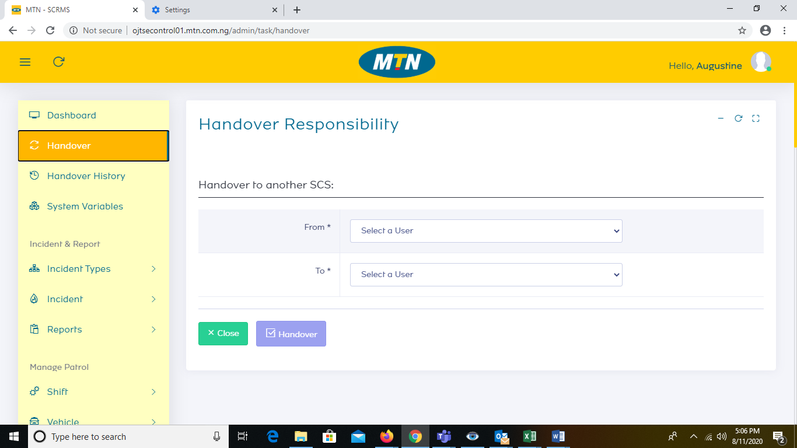
Step 1 >> “ Handover Responsibility ”
{
{

Slide 80
Task Report Visualizer
Update Task
Progress Update
Response Requirement
Assign Patrol Team , Police Ambulance and fire Services

